Slide 1

Titanium Certified Developer (TCD) Training
Andrew McElroy
@Sophrinix

Slide 2
WELCOME TO
Titanium Certified Developer (TCD) Training

Slide 3

AGENDA – Day 1
Course Overview
Getting Started
Titanium Basics
JavaScript
Alloy Overview
User Interface

Slide 4
Daily Schedule
Day 1 | Day 2 | Day 3
Course Overview Getting Started Titanium Basics JavaScript Alloy Overview User Interface | Models & Collections Networking Multimedia Filesystem Geolocation & Mapping | Appcelerator Cloud Services Web Content Debugging & Tools Deploying for Testing Publishing
Q&A, Hacking | Q&A, Hacking | Q&A, Exam

Slide 5
INTRODUCTION
Titanium Certified DevelopER (TCD) Training

Slide 6
Course Material
Labs @ Appcelerator Wiki (included code)
PDF version of this presentation available by Instructor.

Slide 7
Introduce Yourself
Name
What's your dev background?
What's your Appcelerator Titanium experience?
Notes:
Try to keep the introductions to 10 mins, total for the whole class

Slide 8
Housekeeping
Class Hours
Parking
Restrooms
Meals
Network Connectivity
Phones/ Pagers
Smoking
Local Emergencies
Fire Exits

Slide 9
Course Objectives
Create cross-platform Appcelerator Titanium apps
Use Alloy to structure your app's code
Use core Titanium UI and non-UI APIs
Debug your apps
Deploy and publish your app

Slide 10
Daily Schedule
Day 1 | Day 2 | Day 3
Course Overview Getting Started Titanium Basics JavaScript Alloy Overview User Interface | Models & Collections Networking Multimedia Filesystem Geolocation & Mapping | Appcelerator Cloud Services Web Content Debugging & Tools Deploying for Testing Publishing
Q&A, Hacking | Q&A, Hacking | Q&A, Exam

Slide 11
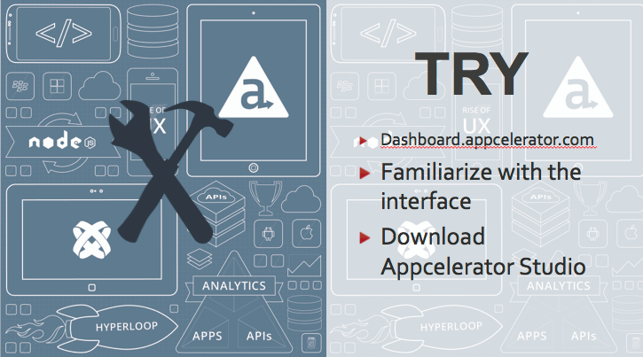
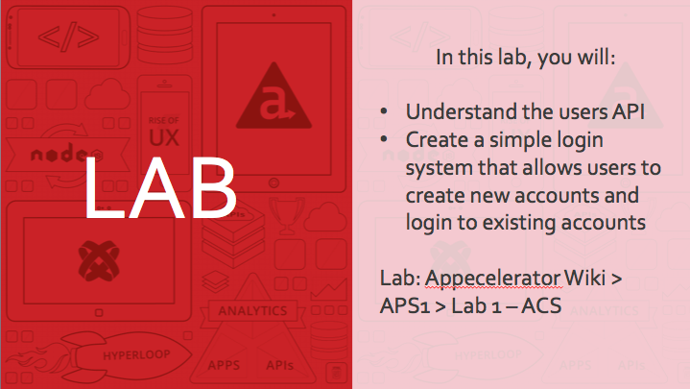
Follow Along
TRY IT sections
LABS
PDF with slides
Lab code
Notes:
Explain students what they will be doing and how to follow along the training experience.

Slide 12
Q&A
Here are some ideas
Am I supposed to know Javascript?

Slide 13
GETTING STARTED
Titanium Certified DevelopER (TCD) Training
Notes:
Lesson time: 30 mins teaching
no lab

Slide 14
In this lesson, you will:
Explore the market, features, and typical use-cases for Appcelerator Titanium
Examine the basic Titanium architecture
List the steps in the app development process
List the resources available to help developers

Slide 15

APPCELERATOR TITANIUM OVERVIEW

Slide 16
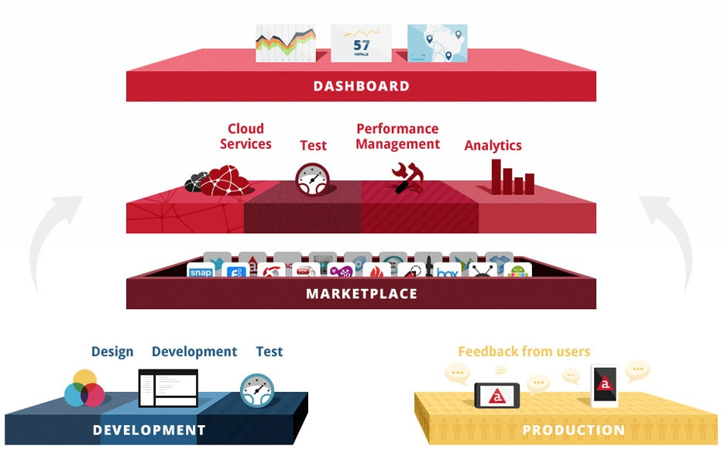
Appcelerator Platform Overview
Notes:
The Appcelerator Platform provides enterprises the tools they need to manage the complete application lifecycle, from development, deployment, to monitoring and feedback. It combines various components and provides real-time monitoring tools.

Slide 17
Appcelerator vs. Titanium
Enterprise (Appcelerator) | Community (Titanium)
Titanium SDK | Titanium SDK
Appcelerator Studio | Titanium Studio
Cloud Services | Cloud Services
Appcelerator Dashboard
Appcelerator Test
Performance Management
Analytics
Live View
Support & services

Slide 18
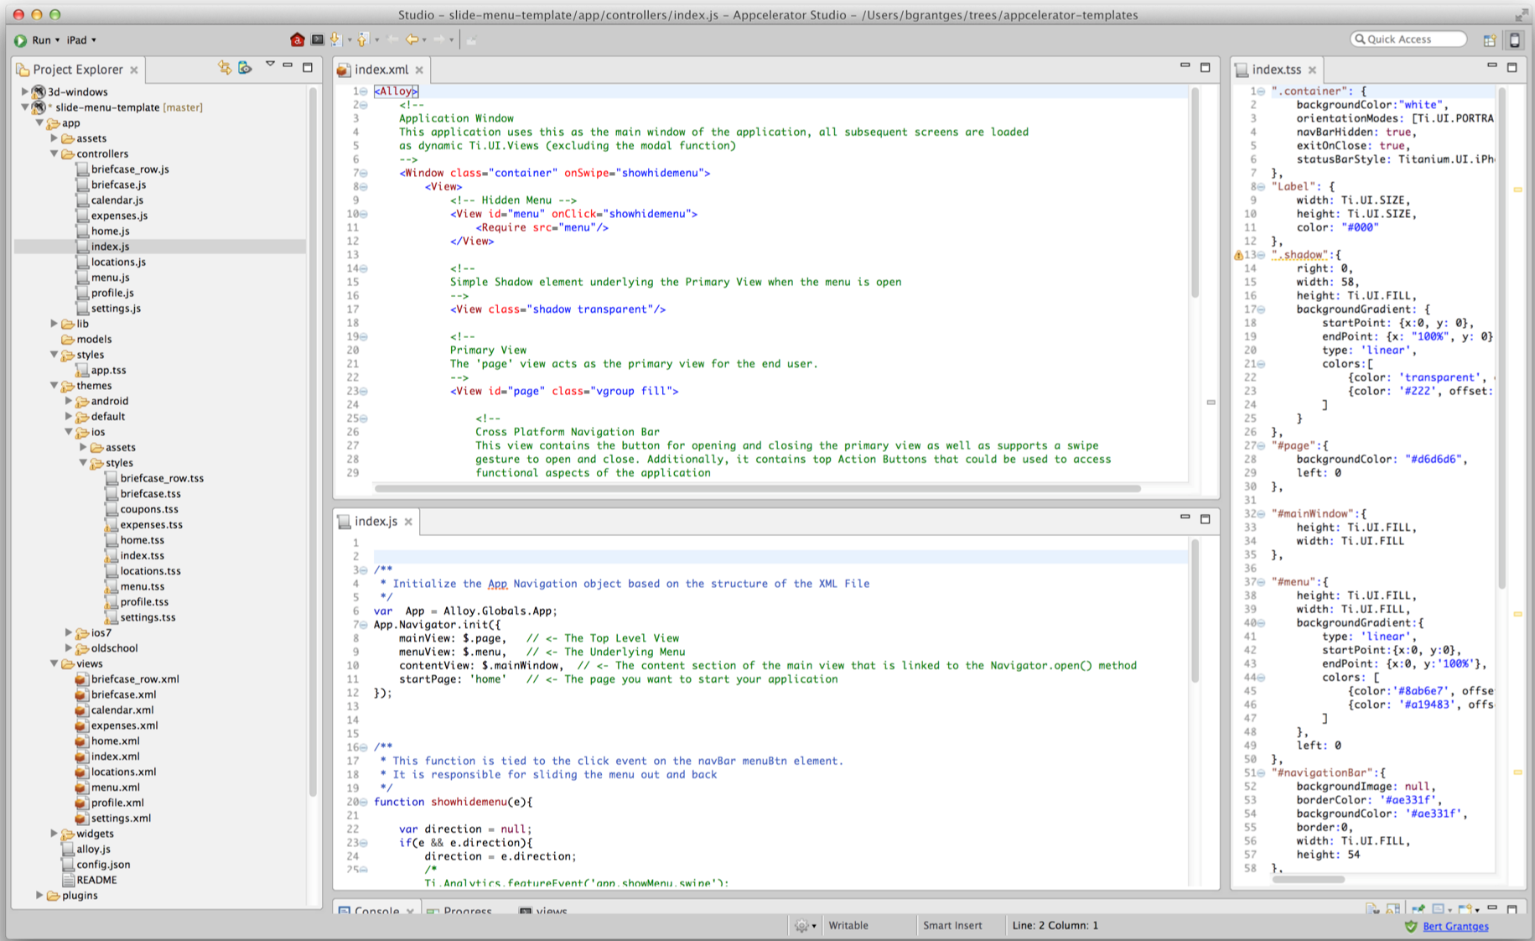

Titanium Studio
Notes:
Appcelerator Studio is the starting point to get access to the difference services that Appcelerator platform offers
Appcelerator Studio tools: Enabling appcelerator services, Liveview, Profiler, etc

Slide 19

Appcelerator Executive Insights
Notes:
track user acquisition, engagement, retention and quality metrics for your mobile apps. The Appcelerator Insights application is aimed for business users as opposed to the Appcelerator Dashboard, which is aimed at technical users.

Slide 20
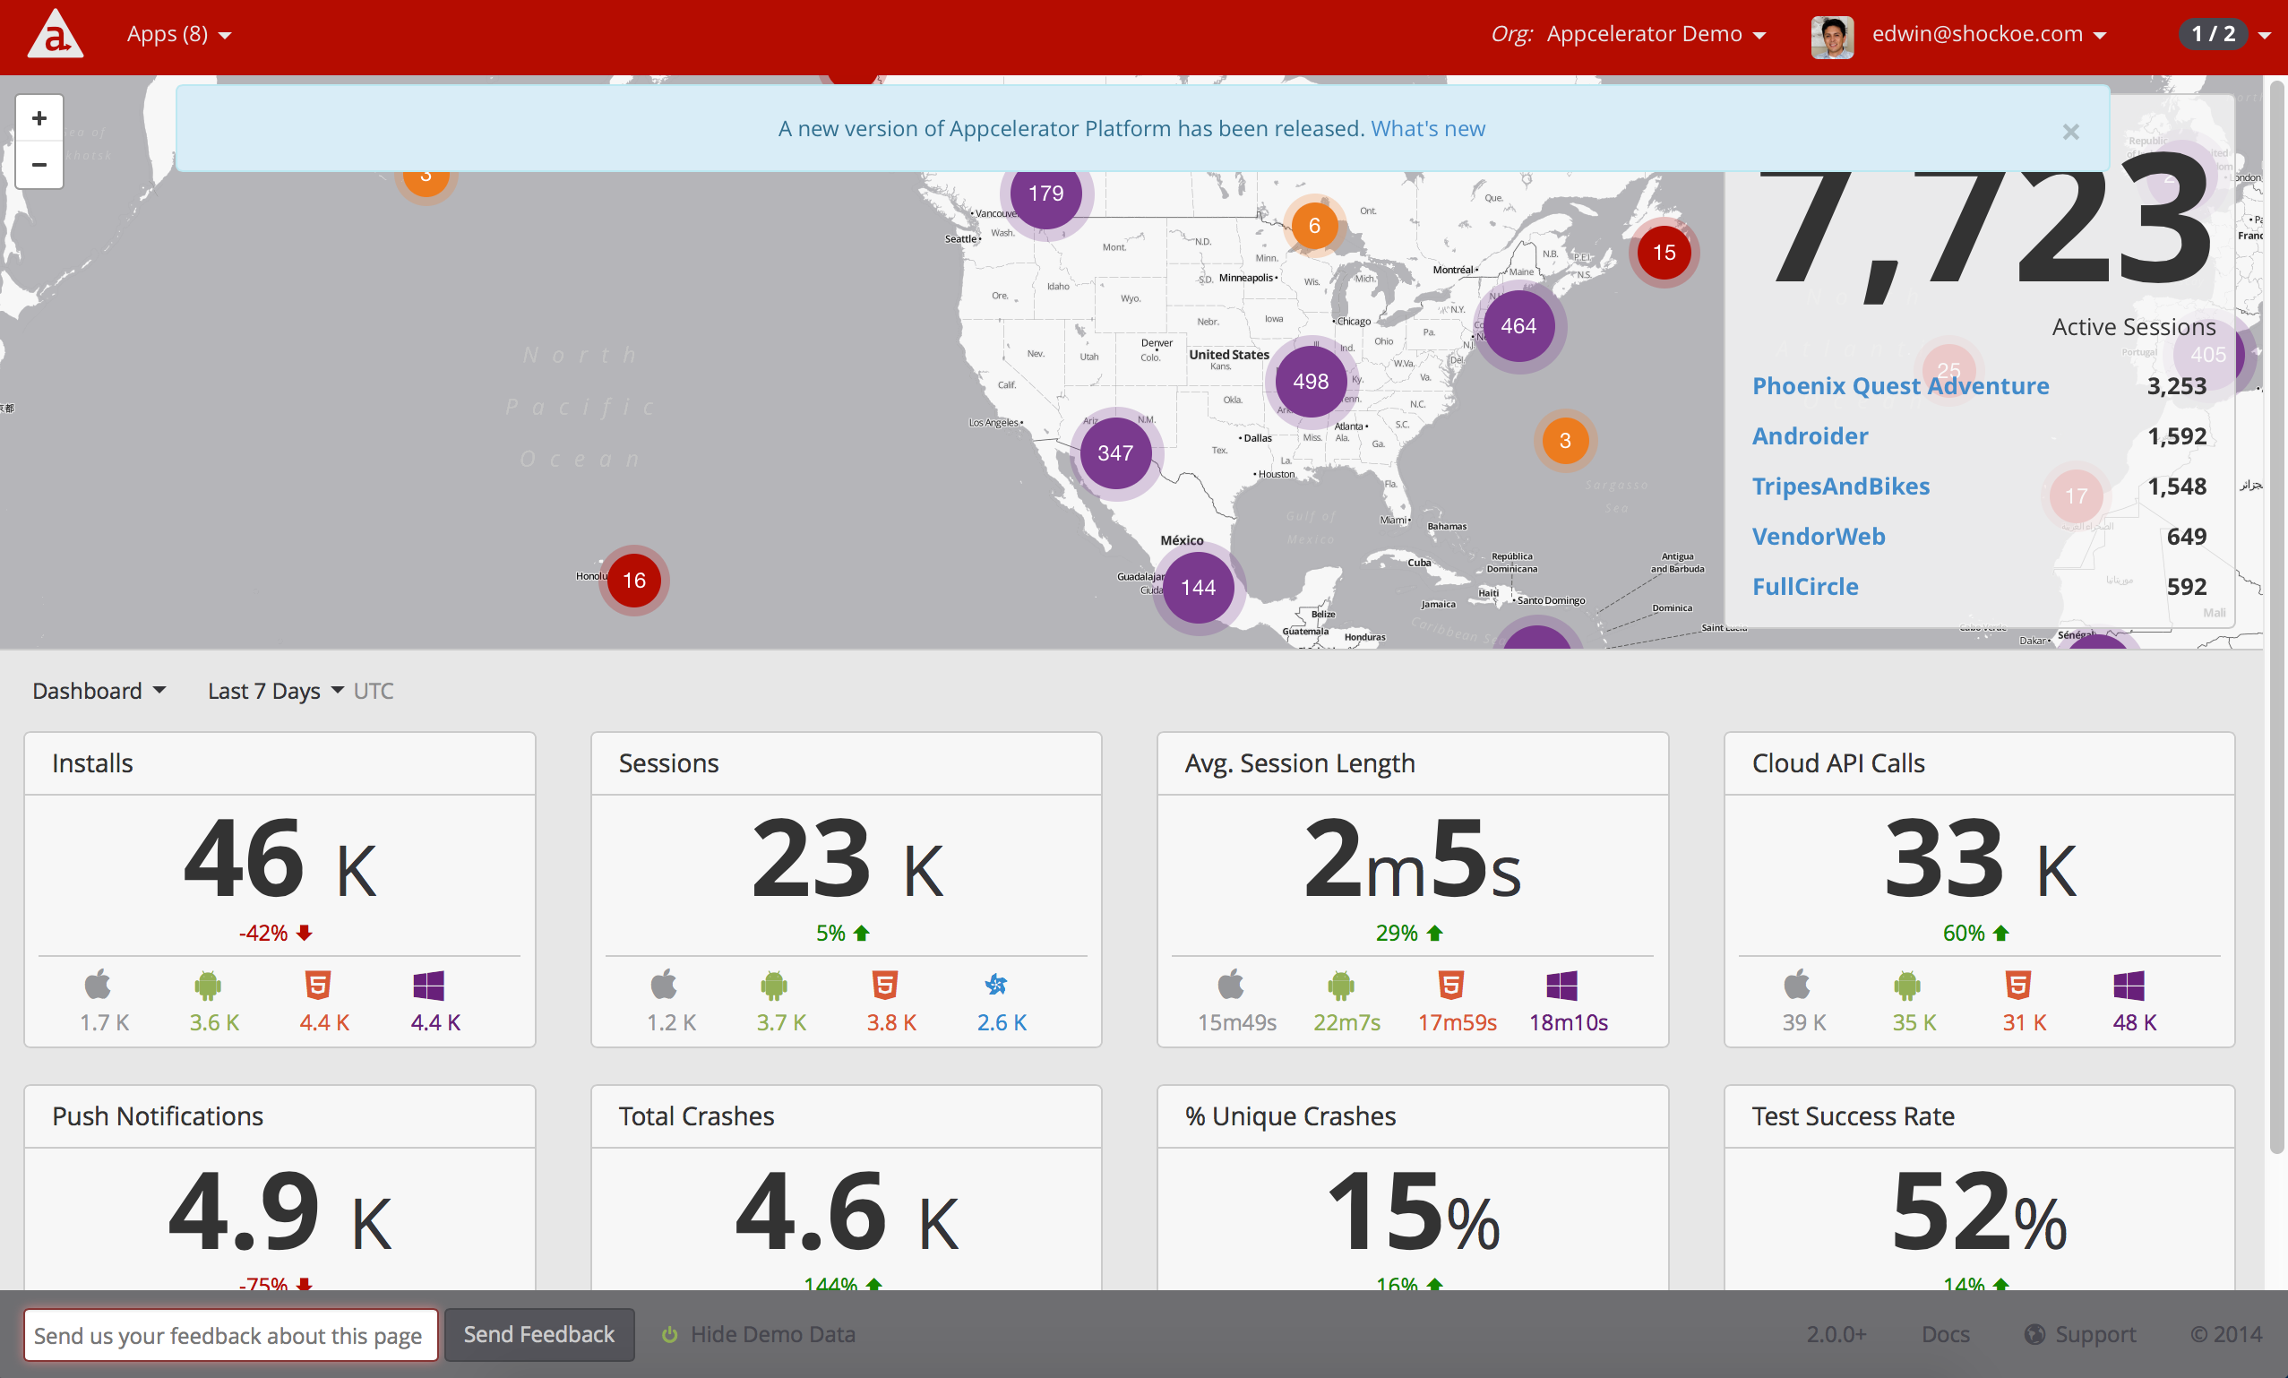
Dashboard
Notes:
A web portal used to monitor your application's heath and usage. This dashboard is aimed for technical users.

Slide 21
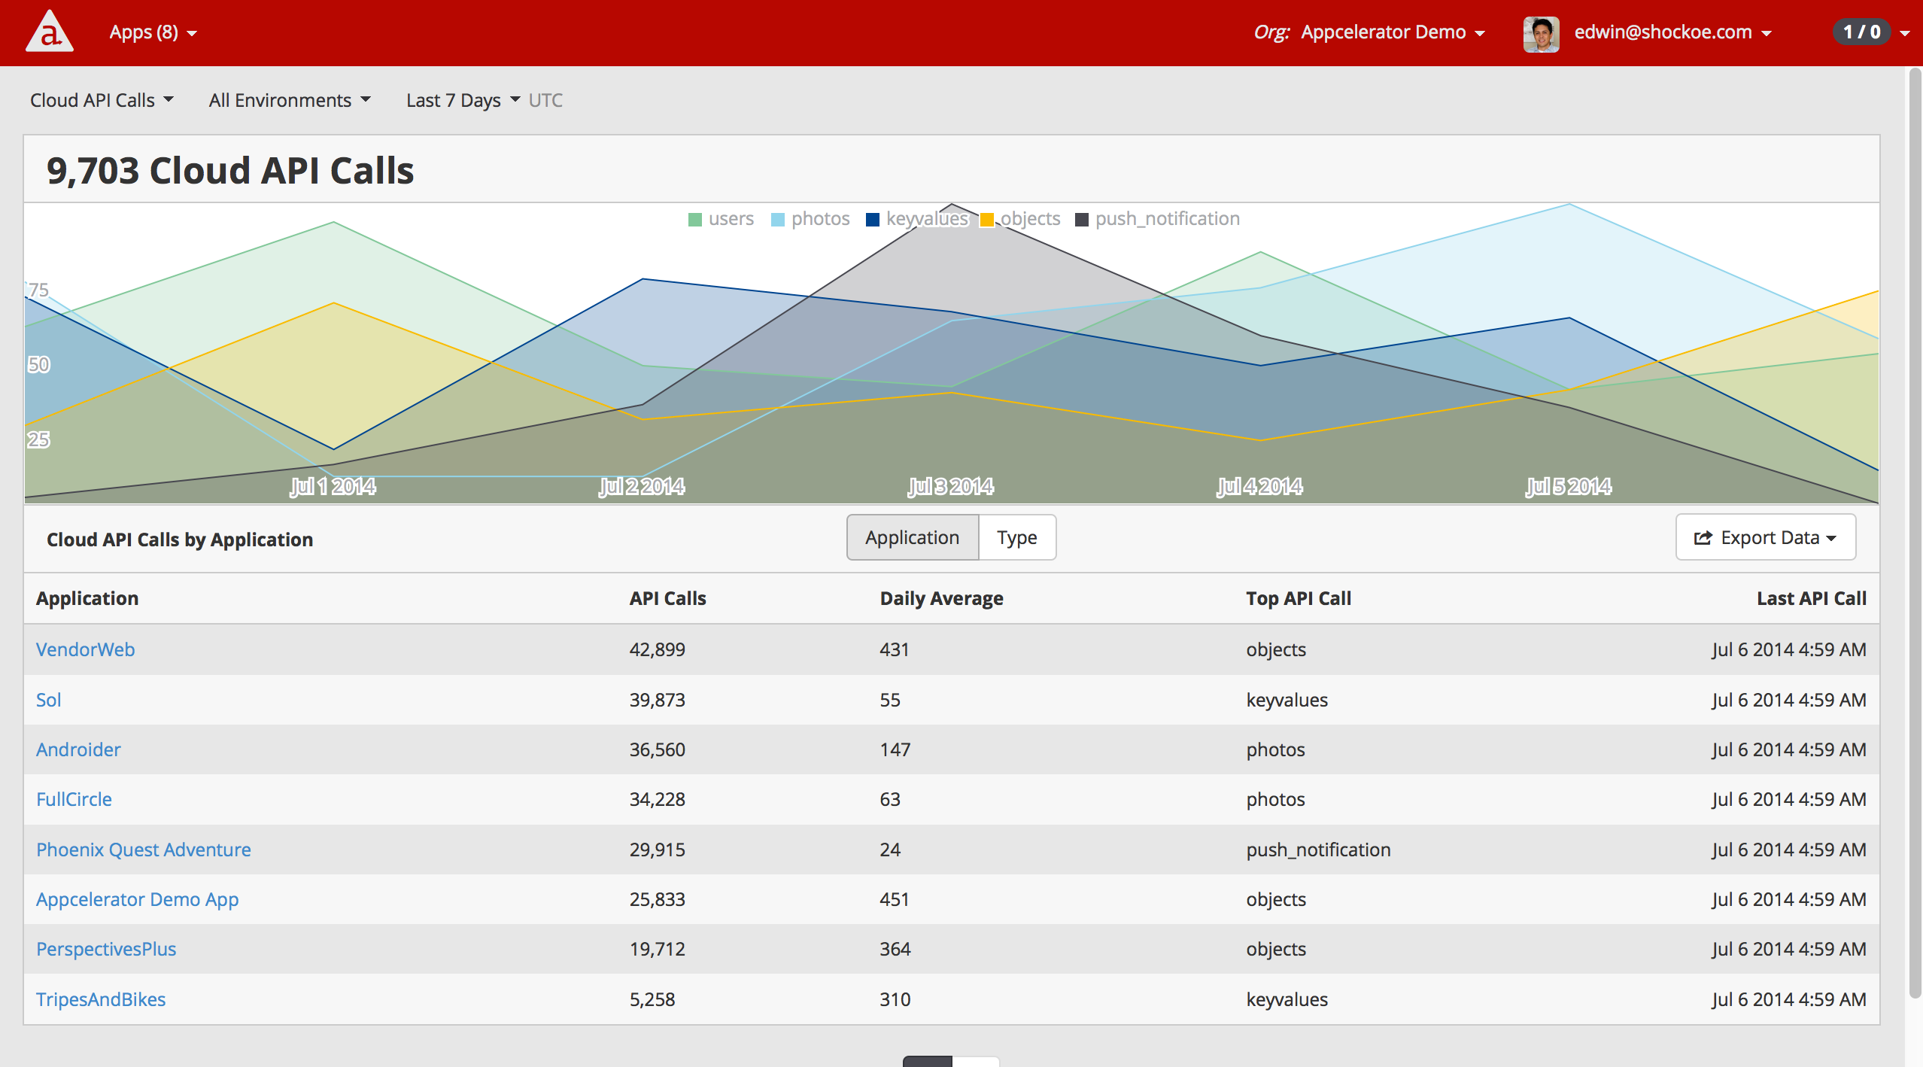
Appcelerator Cloud Services
Notes:
Mobile backend-as-a-service solution providing commonly used features, such as user management, push notification, integration with social networks and cloud storage. Using Appcelerator Cloud, developers can quickly and easily create mobile-optimized APIs that manage data from multiple data sources, such as SAP, Salesforce.com, Oracle, Sharepoint and others

Slide 22
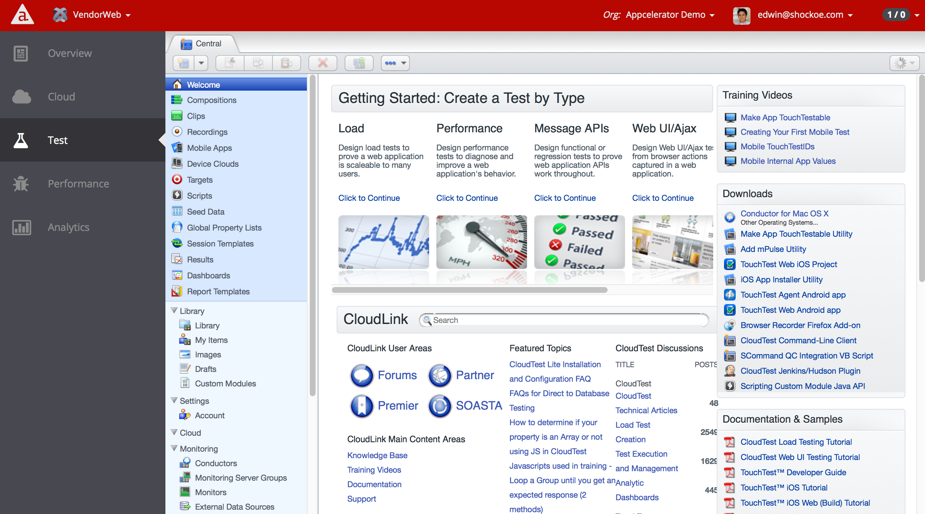
Appcelerator Test
Notes:
Appcelerator Test, enabled by SOASTA’s TouchTest™ mobile test automation solution, provides precision recording, playback and results analysis of automated mobile tests. Appcelerator Test lets you capture, compose and edit tests that include precision gestures, such as swipe, pinch, and pans.

Slide 23
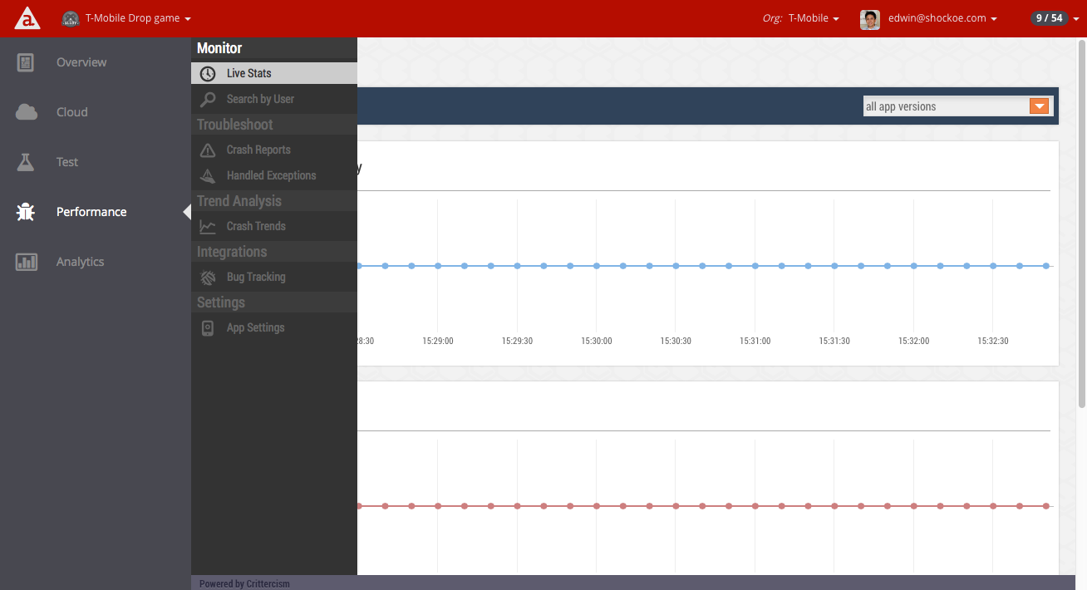
Appcelerator Performance Management
Notes:
The Appcelerator Performance service, powered by Crittercism, monitors your application's health, crashes and overall performance. Using Appcelerator Performance, developers are able to analyze crash reports to see why applications crashed and focus on the specific problems on user feedback.

Slide 24
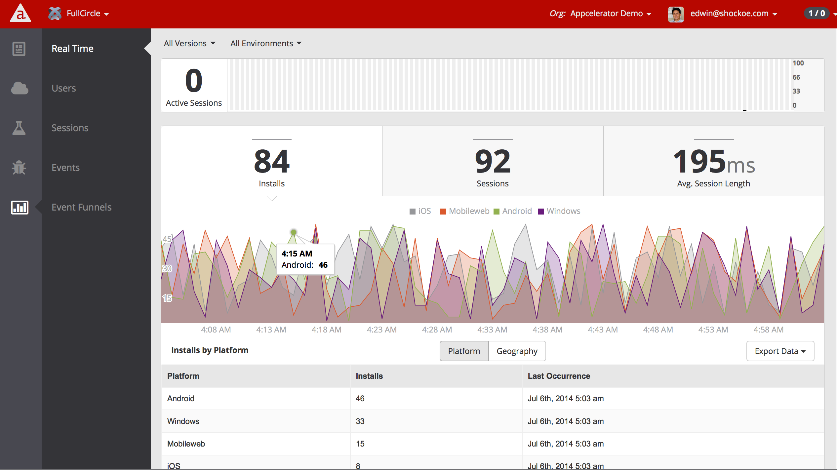
Appcelerator Analytics
Notes:
Appcelerator Analytics collects and presents information in real time about how your application's user acquisition, engagement and usage. By default, it provides the number of applications installs, the number of sessions, and the average application session length organized by application name, platform and geography. You can optionally send custom analytic events, which are collected and logged by Analytics, to track feature usage within your application, and to better understand how users work through an application. You can also create event funnels —ordered sets of custom events that correspond to a business process or application flow you want to track as a whole.

Slide 25
Appcelerator Executive Insights
Notes:
track user acquisition, engagement, retention and quality metrics for your mobile apps. The Appcelerator Insights application is aimed for business users as opposed to the Appcelerator Dashboard, which is aimed at technical users.

Slide 26
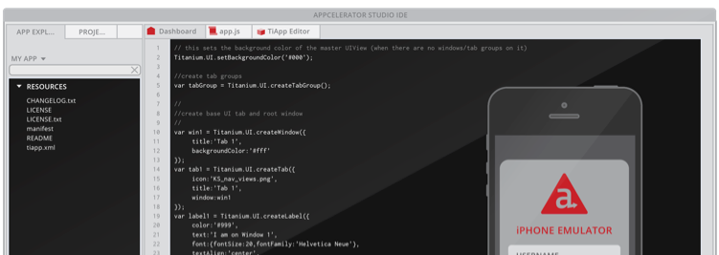
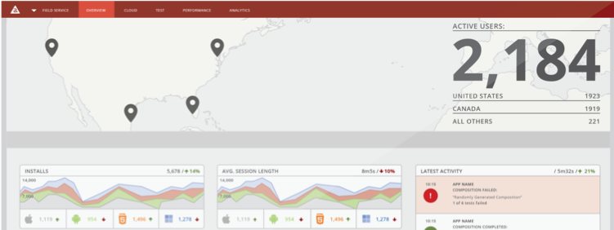
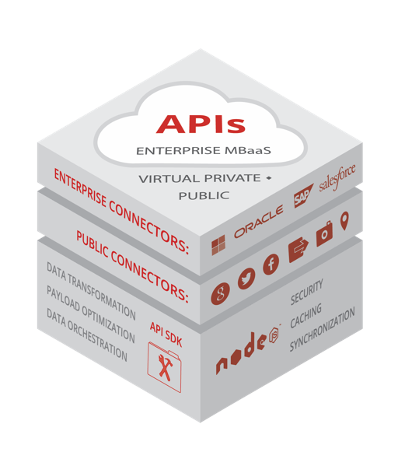
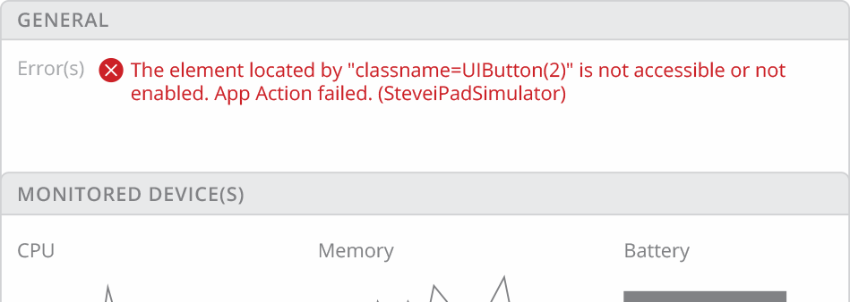
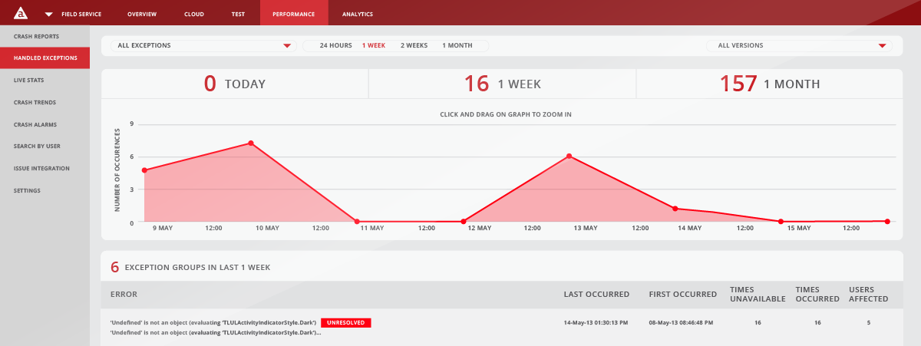
CROSS PLATFORM DEVELOPMENT
REAL-TIME ANALYTICS
Maximize your existing resources, produce engaging user experiences, and decrease time of development
Make informed decisions through out the mobile application lifecycle
TEST AUTOMATION
PERFORMANCE METRICS
MBaaS
Iterate faster and reduce QA time by up to 90% while increasing the overall quality of the application(s)
Actionable data in real-time to reduce the mean time to resolution of production issues for your mission critical applications

Slide 27
Supported Mobile Platforms
iOS - iPhone, iPad, iPod Touch
Android - handsets and tablets
Mobile Web (HTML5)
BlackBerry 10
Windows Phone 8 (Pre-release – Fall GA)

Slide 28












Powered By Titanium
Over 75K apps on App Stores!
Notes:
Try opening appcelerator.com/customers/app-showcase
More than 370,000 developers and over 230M devices running apps built on Appcelerator

Slide 29
ARCHITECTURE

Slide 30
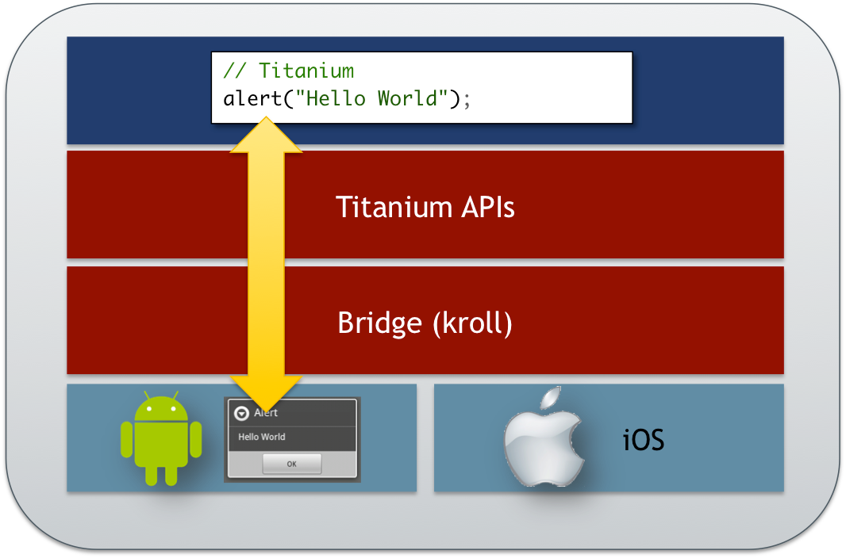
How Titanium Works
You write Javascript
Titanium maps your JavaScript code to native components
Communication is two-way across the bridge
Notes:
When you create something, like a button, in JavaScript, Titanium creates a native equivalent for you
When you modify the button (set it's title or color), Titanium maps that change to native land
When the user clicks the button, your JavaScript code can react

Slide 31
Titanium Key Points:
You write in JavaScript
There's a platform-specific bridge and set of native components (so your source code can run on multiple platforms)
Your JavaScript is still there and running on the user's device
Your app is compiled (so your code is secure)

Slide 32
Cross-Platform in Titanium
Cross-platform !== 'Write Once, Run Everywhere‘
Titanium is 'Write Once, Adapt Everywhere‘
Goal is to build 'Best of Breed' apps
Non-visual code up to 100% portable
Accept and embrace platform differences

Slide 33
Titanium Provides APIs For:
UI components — add native buttons, pickers, tables and more to your apps
Networking — HTTP/HTTPS, sockets, Bonjour
Local storage — file, database, app properties
Camera, GPS, accelerometer
Social APIs — Facebook, YQL, more
Extensible & modular to add on custom functionality

Slide 34
DEVELOPMENT PROCESS

Slide 35
App Dev Process
Write your source in JavaScript
Build for simulator/emulator/test device
Debug/test
Publish

Slide 36
Build Process
Node.js scripts analyze your JavaScript and interact with native tools
Your code is packaged into native project
Platform-specific interpreter included
iOS: JavaScriptCore
Android: V8
Native project is compiled using platform-specific tools
If building to device, project is code-signed using native tools
Notes:
Key point is that your JavaScript code is not accessible to end users. In production, the code is minified, obfuscated, and encrypted, then compiled within a native project. Even with this, we're not cross-compiling. Your JavaScript is still evaluated at runtime on the native platforms.

Slide 37
Debugging/Testing Overview
Syntax checking in Studio
Logging messages
Breakpoint debugging in simulator/emulator and device
Native tools for memory inspection
Appcelerator Test for automated functional testing

Slide 38
Publishing Overview
Your code is minified and further compiled than with development builds
Images are optimized with a pngCrush style optimizer
App is signed with your publication certificates
Stored on the file system (Android) or synced to Xcode Organizer (iOS) for native publishing process (AdHoc & Enterprise publishing a bit different)
Notes:
code is optimized, as are graphics.
app is signed with publication certificates and stored as appropriate for the target platform.
Then, can continue with the vendor's tools to upload and publish the app.
We'll cover the subtleties of App Store, AdHoc, and Enterprise publishing in the publishing lesson later in the course.

Slide 39
DOCS & RESOURCES

Slide 40
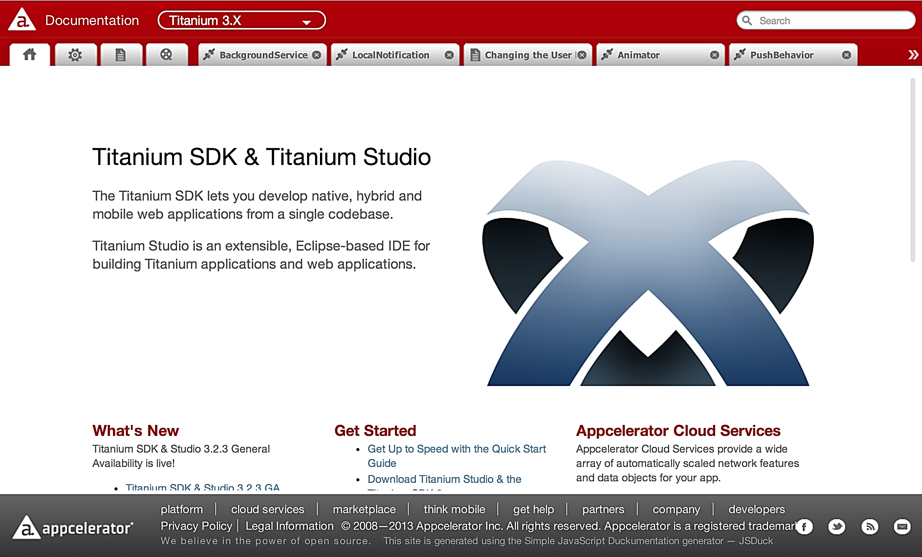
Documentation is Your Friend

Slide 41
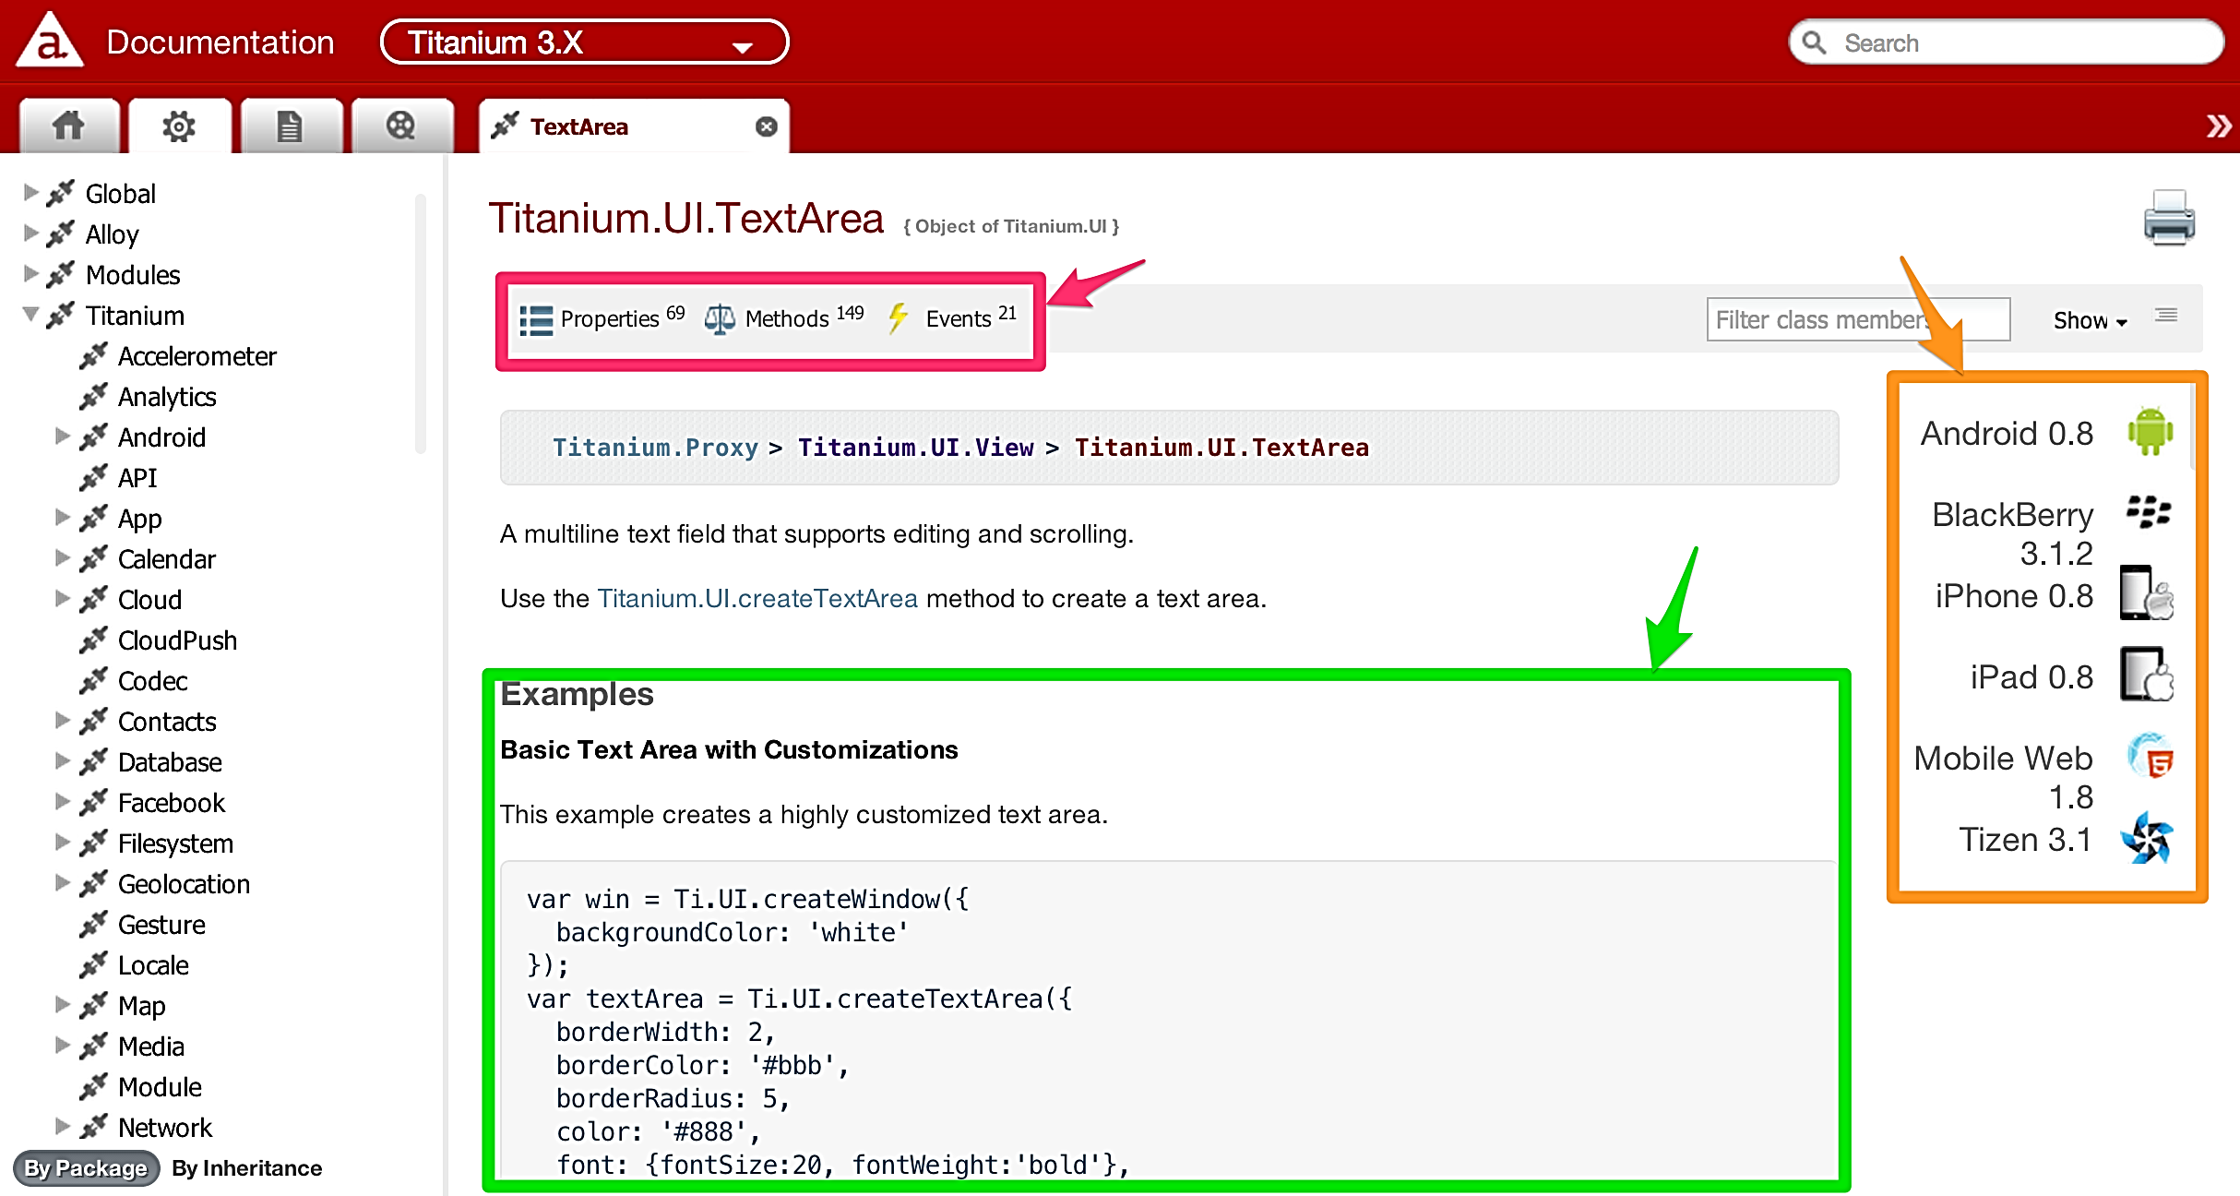
Documentation - More Details
Notes:
Ti.UI.*
Properties, methods and Events per API (magenta)
Some will have examples of how to use them (green)
Some elements will work on specific platforms (orange)

Slide 42
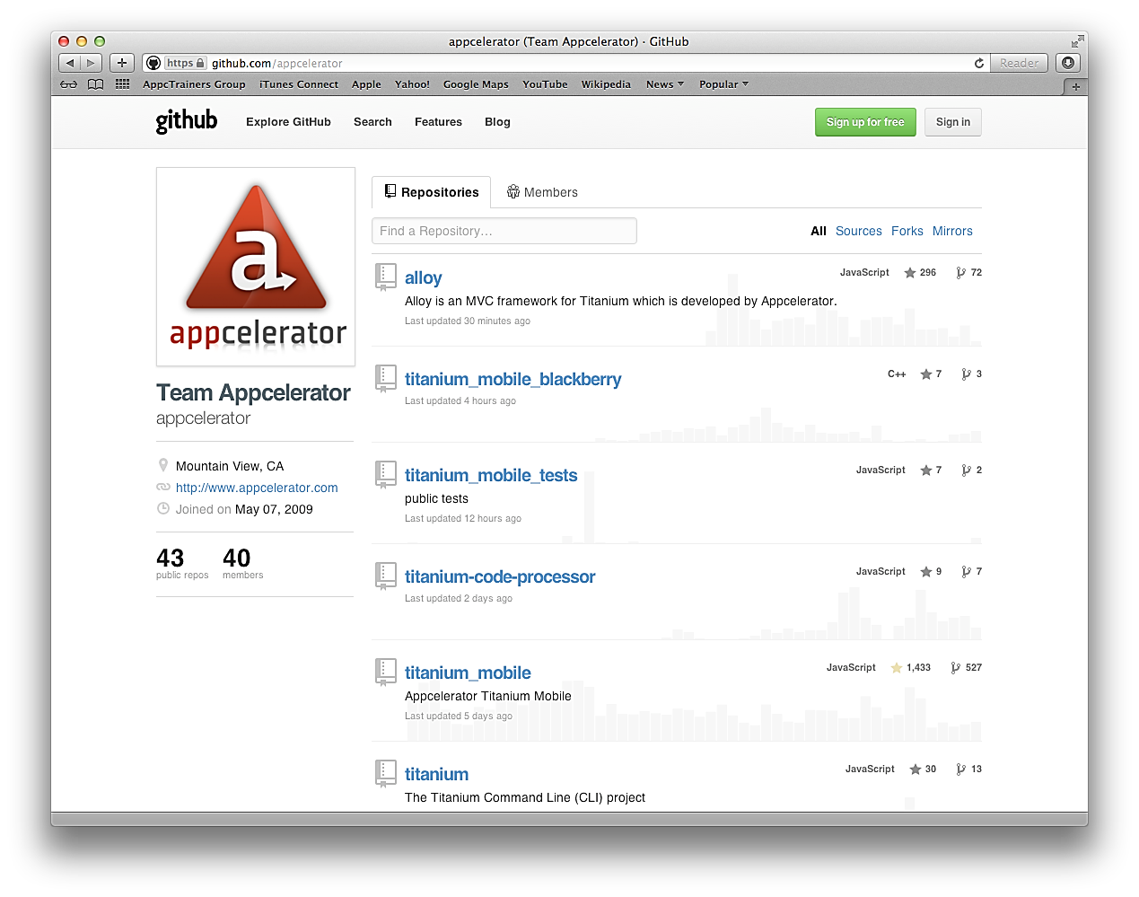
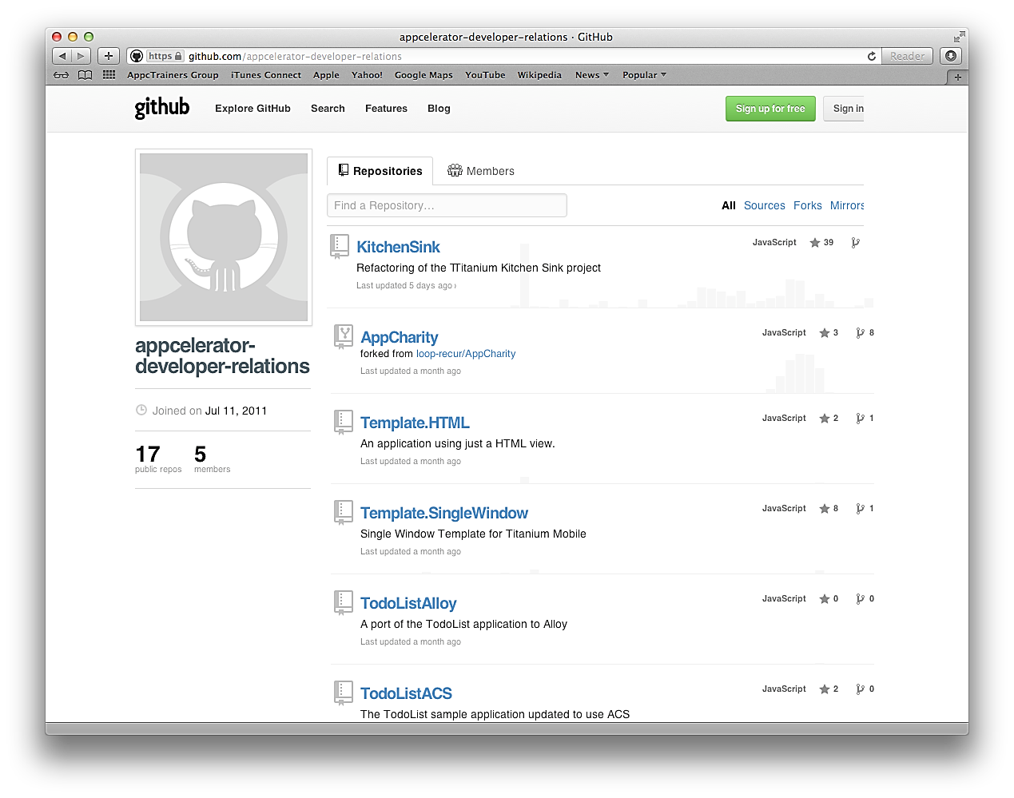
Example Code
https://github.com/appcelerator
https://github.com/appcelerator-developer-relations

Slide 43
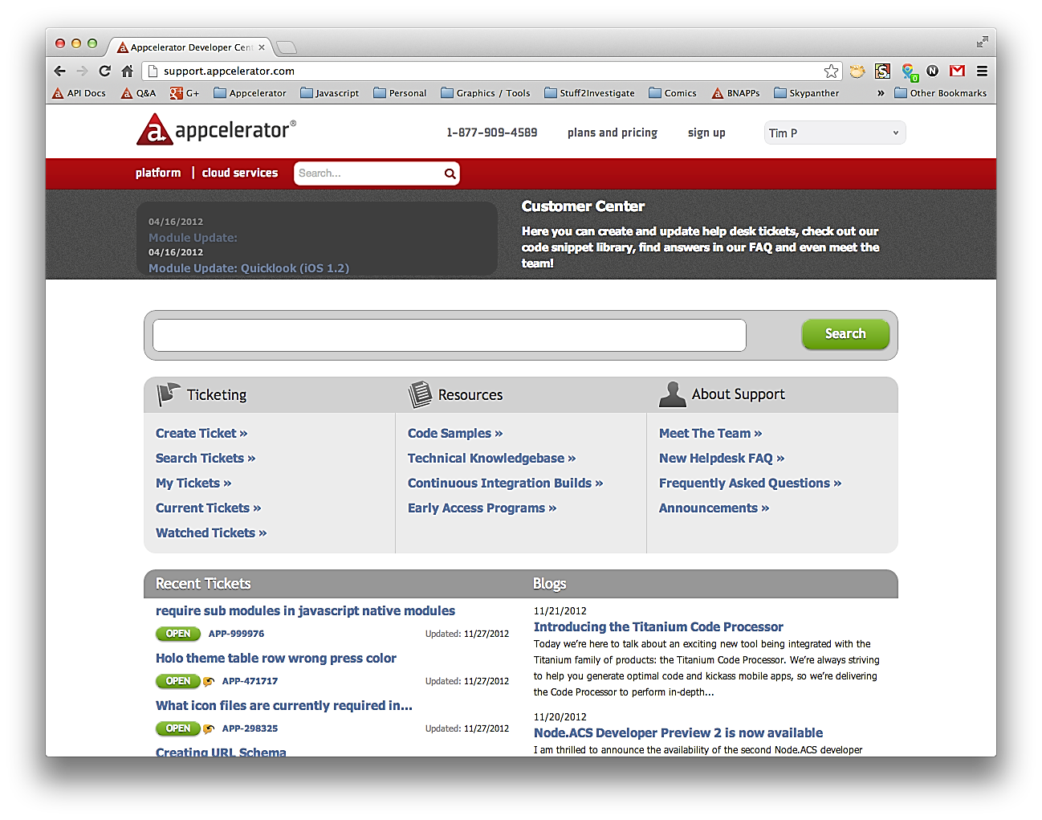
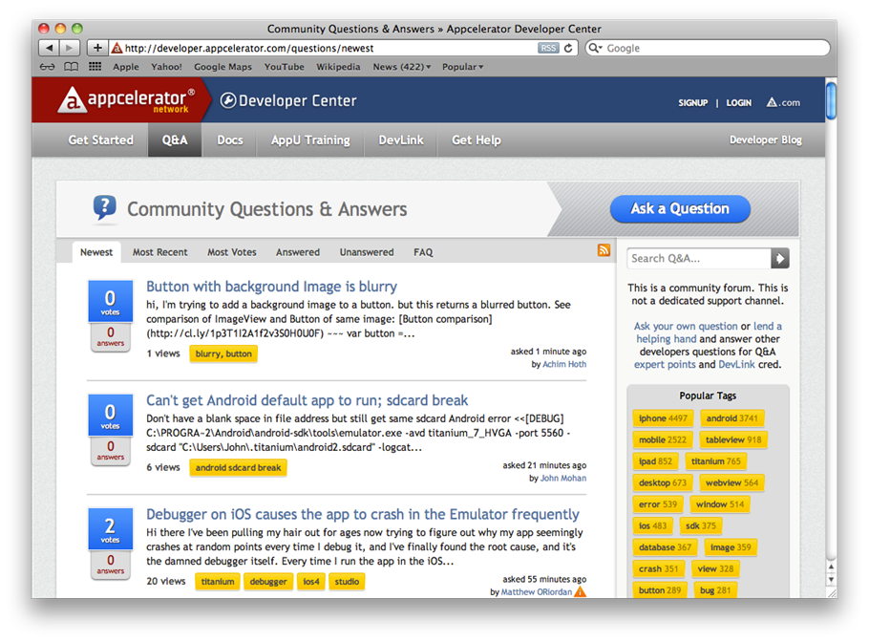
Getting Help
support.appcelerator.com
developer.appcelerator.com/questions/newest

Slide 44
Summary
Explored the market, features, and typical use-cases for Titanium
Examined the basic Titanium architecture
Examined the steps in the app development process
Discovered the resources available to help developers

Slide 45
Q&A
Here are some ideas
What is liveView?
What is the “Bridge”?
Where do I get help?

Slide 46
Titanium Basics
Titanium Certified DevelopER (TCD) Training

Slide 47
In this lesson, you will:
Set up the tools and SDKs needed for Titanium development
Create and configure a mobile project
Build and run a project in the simulator/emulator

Slide 48
TOOLS AND SDKs

Slide 49
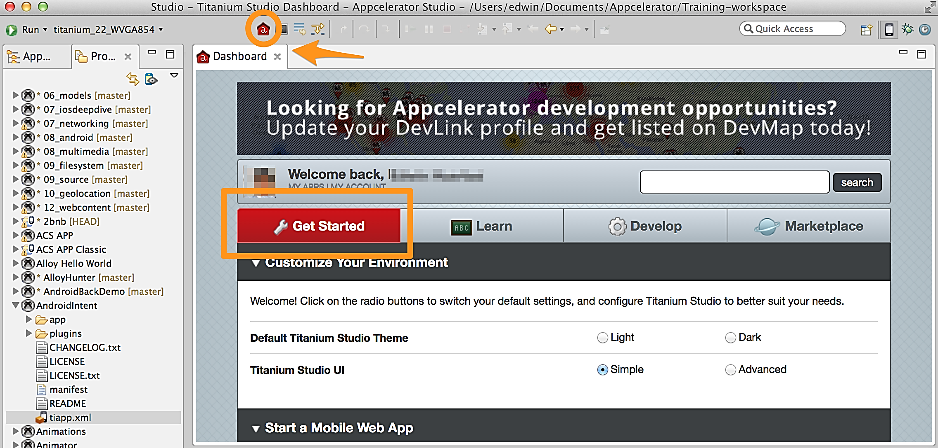
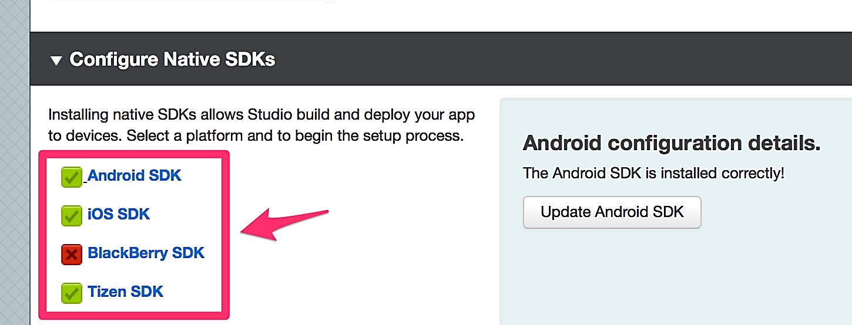
Studio Setup
Runs on OS X, Windows, and Linux
Dashboard will help you through SDK setup steps.
Configure SDK locations:
Click “Get started”
Make sure to set a default Android SDK ... and choose a Google APIs version!

Slide 50
SDKs and Requirements
Native SDKs are required
Android
Oracle JDK (1.7.x)
Android SDK (ADK)
Download platform & tool sets
Path and Environment settings
iOS
Xcode
A Mac! (Intel-based)
BB10
Oracle JDK
BlackBerry NDK
VMWare Fusion for emulator
Windows 8
Visual Studio 2013
VmWare Fusion (mac)

Slide 51
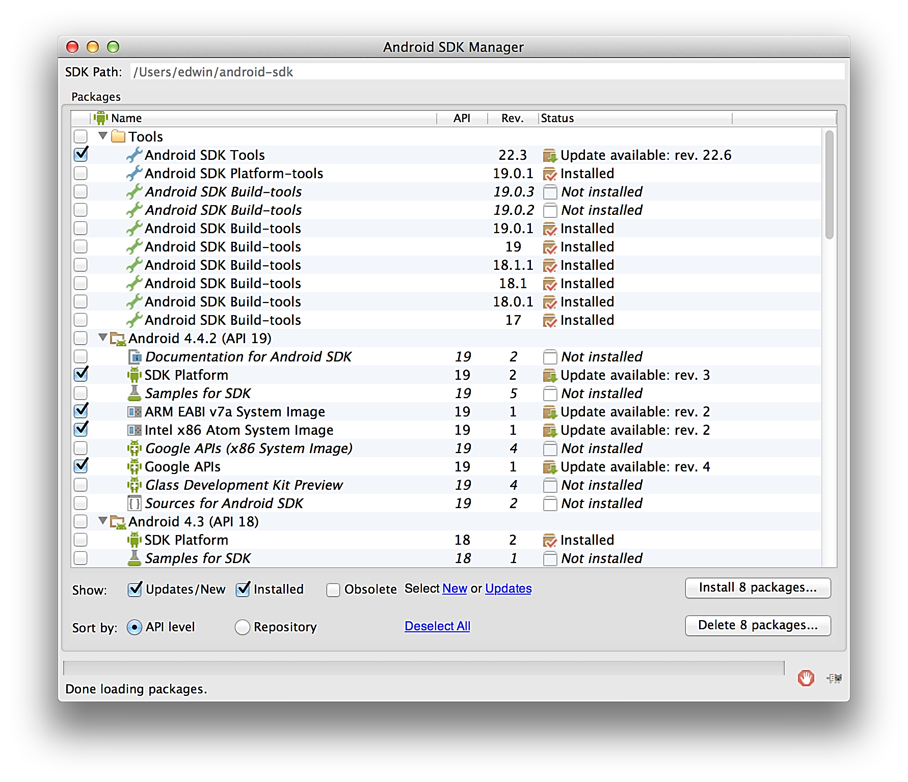
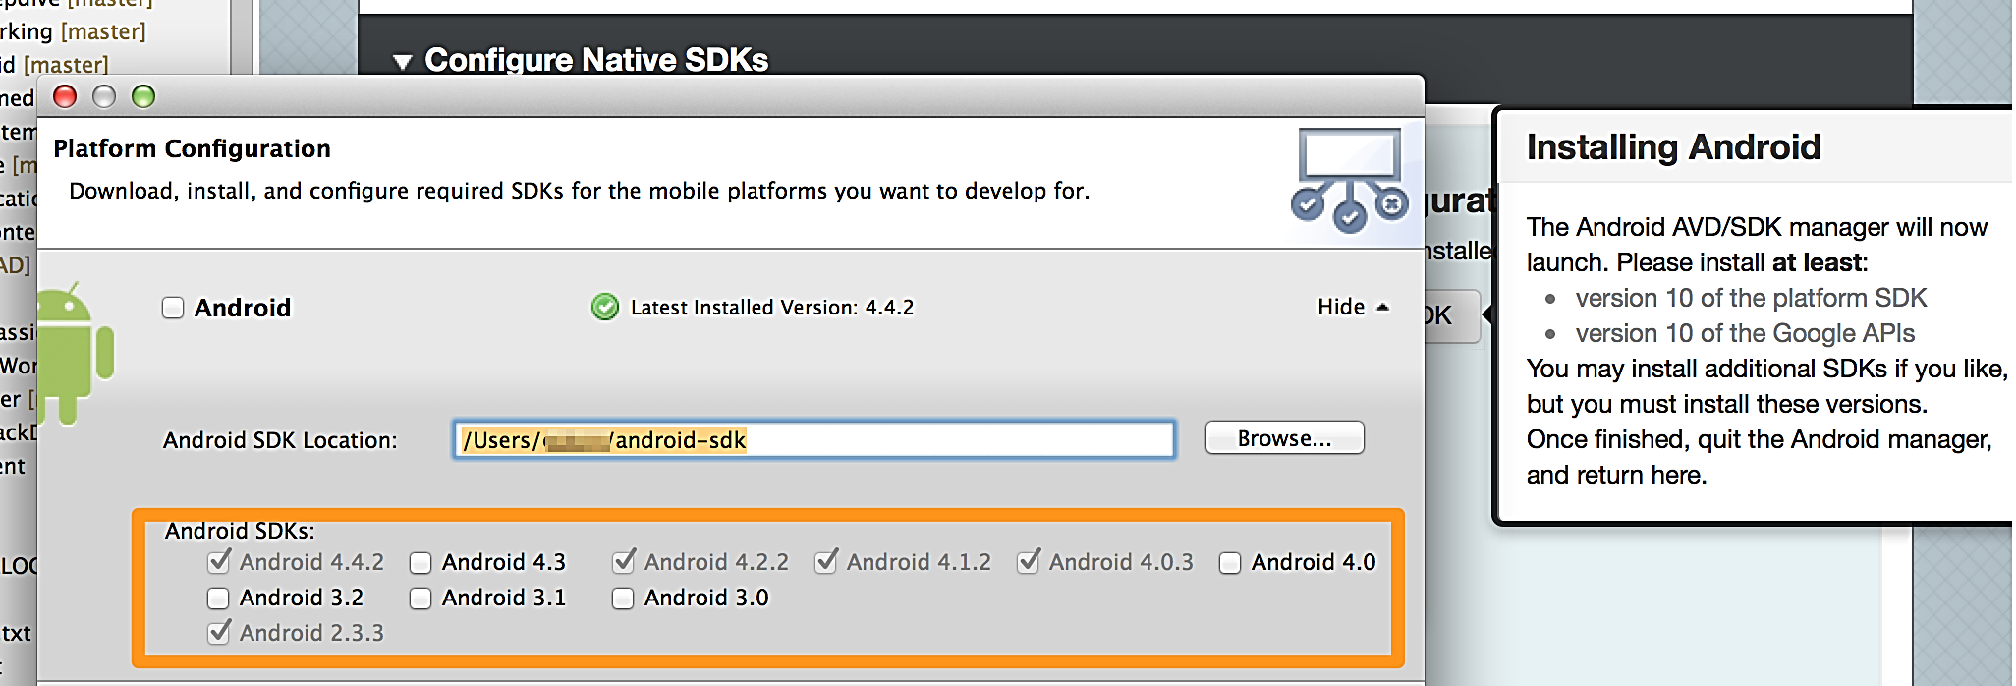
Android SDK Files
Studio will download for you
Use native tool / run android SDK manager
Download, then unzip them

Slide 52
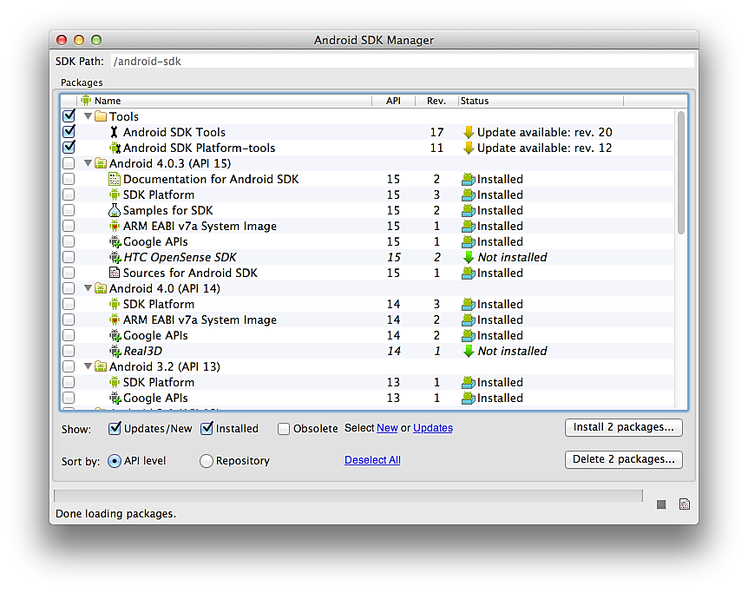
Android Platforms
android script
Download SDK Platform and Google APIs
You must use Google APIs version with your apps
Current mix at: http://developer.android.com/ about/dashboards
Studio will not do this; you should do so periodically
Notes:
Open http://developer.android.com/about/dashboards and show pie chart and explain how this can help to companies decide what users they will target

Slide 53
Path & Environment
Optional, but really handy
OS X
Edit ~/.bash_profile (hidden, might not exist)
Add path to tools and platform-tools folders to your PATH
Restart terminal
Windows
Edit System Properties in Control Panel
Set PATH to both tools and platform-tools directories
Make sure you've also set the JDK's path and JAVAHOME variables
Notes:
Show bash profile example.

Slide 54
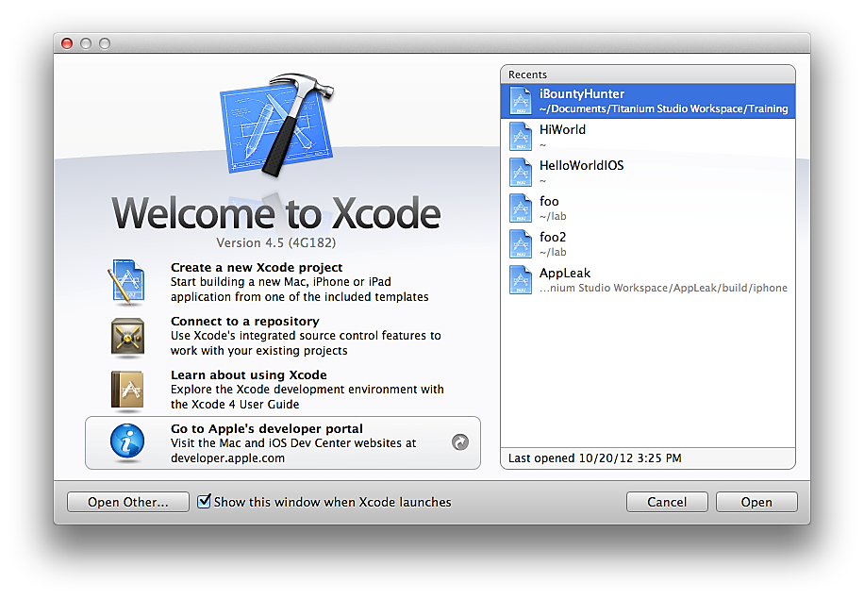
iOS: Xcode
Not much setup
Download from Apple App Store and install

Slide 55
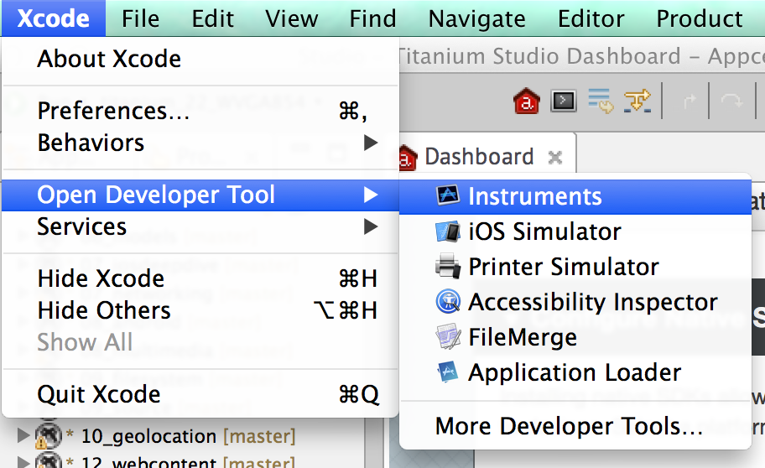
iOS: Handy Tools
iOS simulator
Instruments

Slide 56
CREATING & CONFIGURING PROJECTS

Slide 57
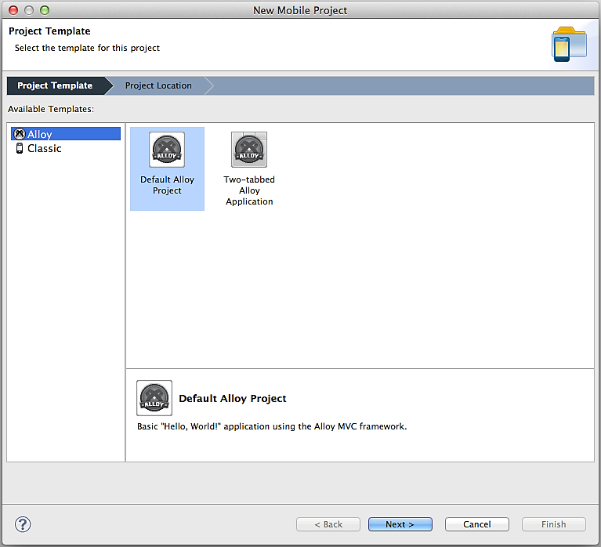
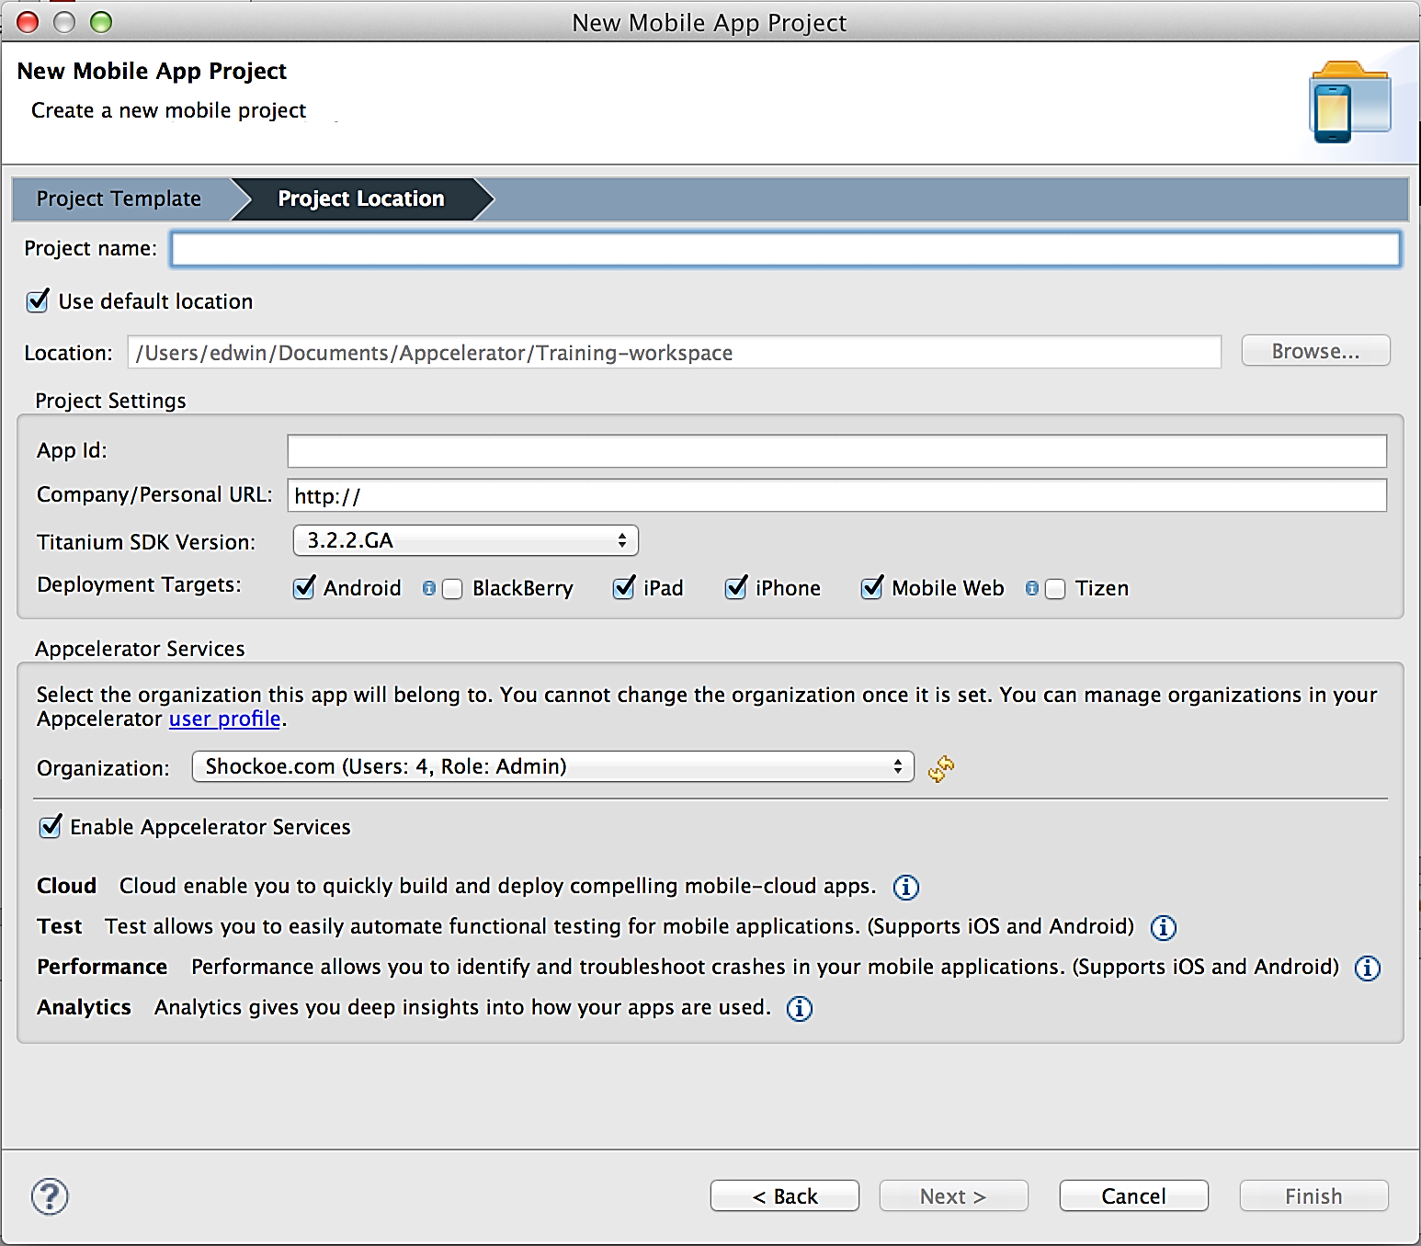
Creating a Project with Studio

Slide 58
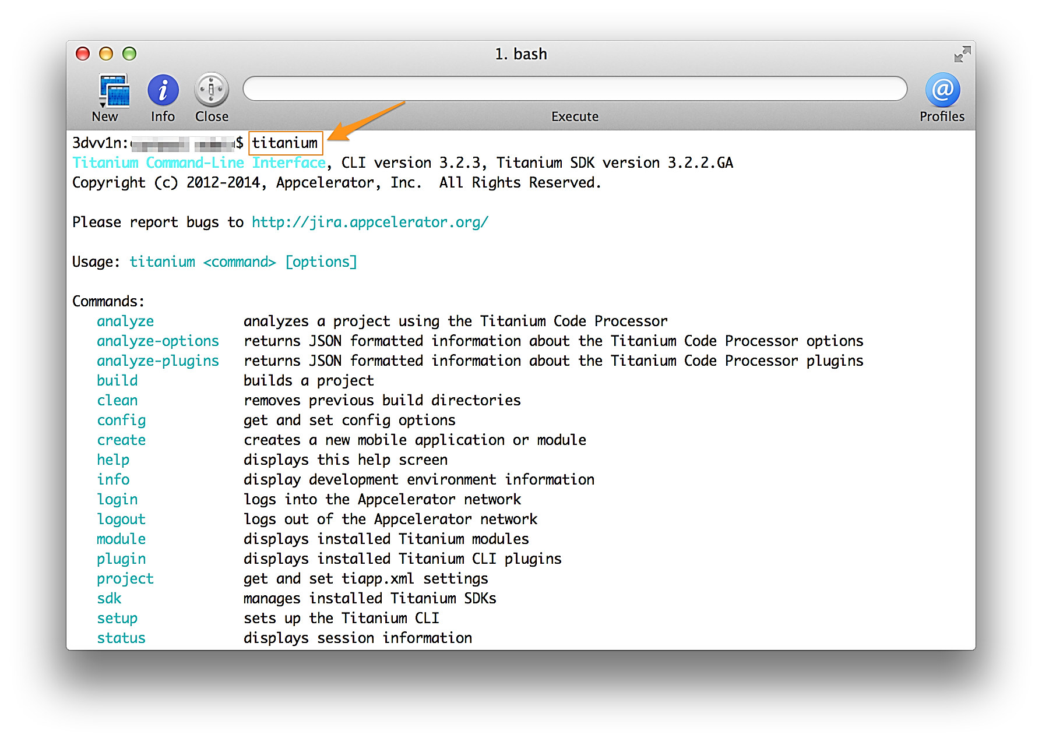
Creating a Project with CLI
If missing paraments, CLI will provide a menu to select them
Titanium create –name <projectnane>
$ ti help

Slide 59
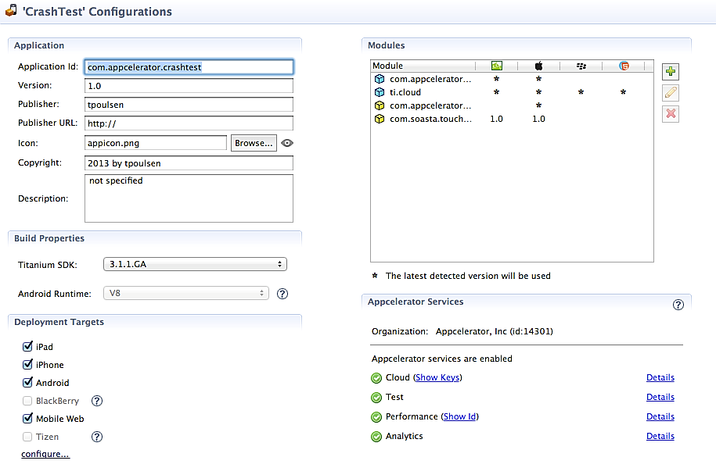
Tiapp.xml Editor - GUI mode
Set App ID, version, and more
Select Titanium SDK and platform support
Specify modules used
Cloud enable

Slide 60
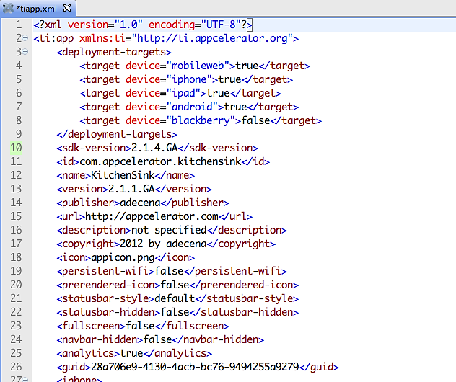
`
Configure orientation support
Platform-specific:
iOS: Info.plist keys,
hardware requirements, etc.
Android: tooling, theme,
custom versioning, etc.
See Guides: Building Native Applications >
Appendices > Tiapp.xml and timodule.xml
Reference

Slide 61
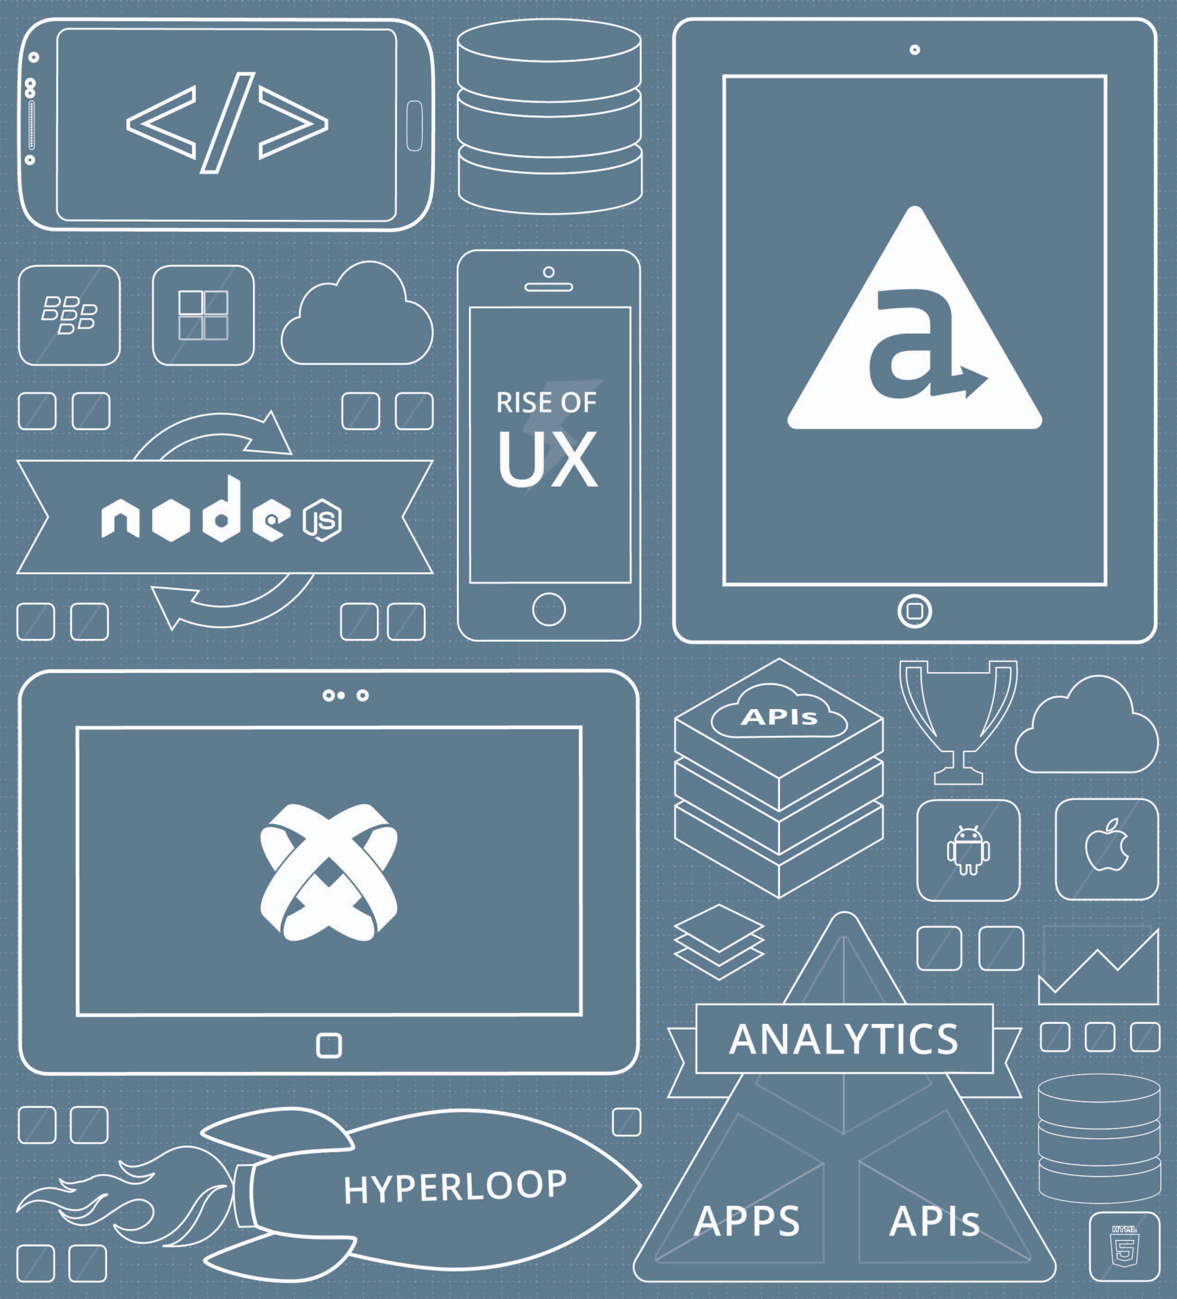

TRY
Create a new project from Studio
Familiarize yourself with folders and files
Look for tiapp.xml file open GUI and XML tabs

Slide 62
BUILDING & RUNNING PROJECTS

Slide 63
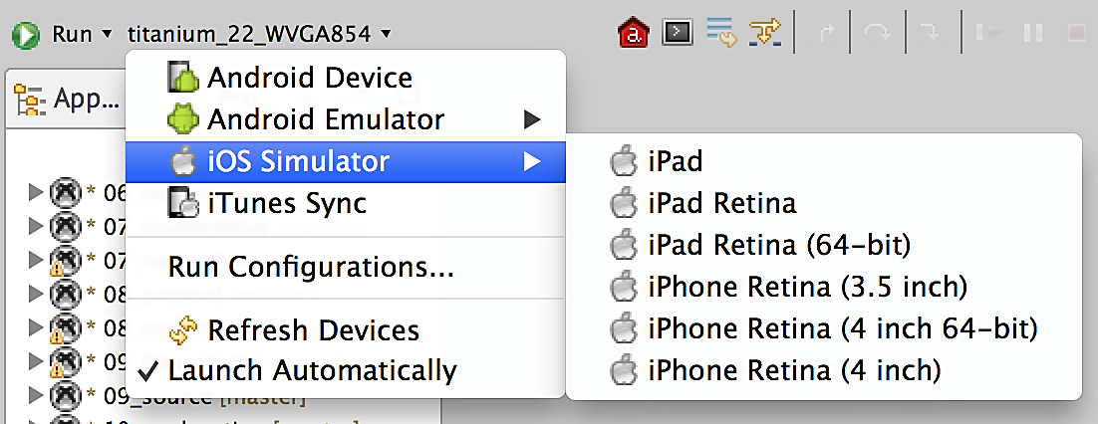
Building a Project
Debug, Run, and Publish menus
Options based on targets configured in Tiapp.xml
Studio does a "preflight" check
For iOS installations, need to configure provisioning profiles

Slide 64
Building at the Command Line
NodeJS-based command line interface
Integrate with custom code repositories, CI configurations, more
Integrate with editors other than Studio
$ ti help

Slide 65
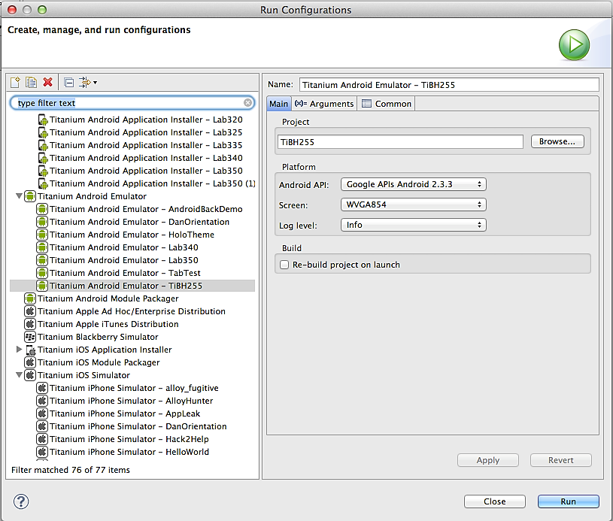
Build Options
Build once
Choose Run > Run Configurations
Locate by platform & project
Or use the CLI!

Slide 66
Summary
In this lesson, you:
Set up the tools and SDKs needed for Titanium development
Created and configured a mobile project
Built and ran a project in the simulator/emulator

Slide 67
Q&A
Here are some ideas
Studio or CLI?
How do I install Android / iOS

Slide 68
JavaScript
Titanium Certified DevelopER (TCD) Training

Slide 69
In this lesson, you will:
Examine JavaScript language basics
Understand variables and scope
Create and use functions
Create and use objects and manage inheritance
Write CommonJS modules
Write code that implements JavaScript best practices
Notes:
We encourage students to try out the code as they go. This is especially the case later in the lesson where we start showing off some of JavaScript's more confusing or subtle features (hoisting, inheritance, implicit/explicit returns, etc.).

Slide 70
Try it as we go
Use your browser's console, or
Visit jsbin.com (turn off HTML pane, turn on JavaScript, Console, & Output)

Slide 71
JAVASCRIPT BASICS

Slide 72
JavaScript building blocks
Data
Variables
Statements ("commands")
Conditionals & Control Statements
Functions
Objects

Slide 73
Data Types
1 // integer (whole numbers)
1.23456 // float (fractions)
'this is a string'
"and so is this"
true // or false == boolean
['one', 'two', 'three'] // array
{ color: 'blue', size: 10 } // object
null, undefined, NaN, Infinity // special types

Slide 74
Variables
var x = 1;
var y = 'foo'; // enclose strings in quotes
// declare multiple w/single statement
var i = 0, j = 1, k = true;
y = 4; // reassigns y's value
x = y; // put y's value into x, both x & y hold same value
Always declare using var keyword

Slide 75
Statements
var x = 100 * 2;
var y = Math.round(22/7);
Expressions that create a result
End with a semicolon

Slide 76
Comments
// this is a comment
var foo = 'bar'; // this is a comment too
/*
This is a
multi-line comment
*/

Slide 77
Conditionals & Control Statements
if/else
For loops
While loops
Switch statements

Slide 78
if/else
if(somecondition) {
// do something
} else if(someOtherCondition) {
// do stuff if someOtherCondition is met
} else {
// do this if others aren't true
}

Slide 79
Comparison operators
Operators | Description
==, === | Equals, strict-equals ('equivalent')
!=, !== | Not-equals, not-equivalent
<, <=, <== | Less-than, less-than or equal, less-than or equivalent
>, >=, >== | greater-than, -than or equal, less-than or equivalent
See: http://dorey.github.io/JavaScript-Equality-Table/

Slide 80
== vs. ===
var x = 1, y = '1';
if(x == y) {
// will this run?
}
if(x === y) {
// how about this one?
}
var x = 1, y = true;
if(x == y) {
// will this run?
}
if(x === y) {
// how about this one?
}
== operands converted so data types match, then equality is tested
=== must have same value and same data type; no type casting
Notes:
http://dorey.github.io/JavaScript-Equality-Table/

Slide 81
Ternary operator
var foo = (isGreen == true) ? 'green' : 'blue';
// equivalent to
var foo;
if(isGreen == true) {
foo = 'green';
} else {
foo = 'blue';
}
// general form is (condition) ? val_if_true : val_if_false;
Notes:
The ternary operator is a compact if-else block in a single statement. It can be used any place a statement will work.

Slide 82
An assignment 'trick
var baz = bar || {};
// baz = bar if bar != false (with type conversion, so null, '', false, etc.)
// otherwise baz = {} -- an empty object
// common use
function foo(bar) {
var baz = bar || {};
return baz.someProperty;
}
// equivalent
function foo(bar) {
if(typeof baz == 'object') {
return baz.someProperty;
} else {
return {};
}

Slide 83
Function Declarations
function sum(a, b) {
// do as many statements as needed
return a + b;
}
// then use like this:
var total = sum(100, 200);
Reusable chunks of code
Arguments pass data to the function
return a value at the end

Slide 84
Function Statements
var sum = function(a, b) {
return a + b;
}
// then use like this:
var total = sum(100, 200);
Essentially equivalent to other format
You're defining a variable that will hold a function
Highlights that functions are 'first class citizens' in JavaScript
You can pass a function as an argument to another function

Slide 85
Function Callbacks
var getAsyncData = function(fn) {
// this function does something that takes a long time to finish,
// such as getting data from the network
fn(networkData);
}
var saveData = function(data) {
// this function does something with the data when it's finally available
return successCode;
}
// then use like this:
var success = getAsyncData(saveData);
Great when getAsyncData() might take a long time to run (like when accessing the network).

Slide 86
Objects
var cat = {
breed: 'tiger',
color: 'orange',
hasStripes: true,
growl: function() {
// make scary noise!
}
}
if(cat.hasStripes == true) {
cat.growl();
}

Slide 87
Core vs. Host
Core JavaScript
Overall language rules & syntax
Core operators
Objects like Date and Math
Host environment adds its own objects
Web browser (DOM)
Node.js (server-side functionality)
Titanium (Ti object for mobile components)
Libraries you import (APIs)
Notes:
JavaScript is implemented in various environments. And the features and functionality it offers vary depending on the environment. The core JavaScript features are the same everywhere. This includes core operators, statements, and syntax, plus the core objects like Date and Math. The host environment adds new objects. For example, JavaScript in the browser has access to objects that represent the web page and web browser. Titanium adds the Ti object to core JavaScript, giving you access to mobile features. But in Titanium, you don't have access to the DOM objects.

Slide 88
ECMA & JavaScript Evolution
Original release in late 1995
Standardized by ECMA in 1998
Current ECMA standard is ECMAScript 5 (2010)
JavaScriptCore is Apple's JavaScript engine, used by Titanium on iOS
V8 is the Chrome JavaScript engine, used by Titanium on Android
V8 & JSCore, thus Titanium, support nearly all of ECMAScript 5
Notes:
No need to go deep into the history or evolution of JavaScript here. The key point is to reinforce the message from the preceding slide that in Titanium you have pretty much complete access to the features defined in ECMAScript 5.

Slide 89
VARIABLES

Slide 90
Type Conversions
var one = '1', two = 2, three='three';
// JavaScript will concatenate if either operand is a string
console.log(one + 1); // = 11
// it will convert when a NaN value might result
console.log(one * 2); // = 2
// you can force a data type
console.log(parseInt(one) + 1); //s = 2
console.log(String(1) + one); // = 11
// unless NaN would result
console.log(String(one) * 2); // = 2
isNaN(parseInt(three)); // == true
Automatic
Helper functions
Casting
Notes:
For a humorous look at what automatic type conversions can do, check out http://www.youtube.com/watch?v=_yZHbh396rc (JavaScript coverage begins about 1:20 but the whole video is just 4 mins long).

Slide 91
Variable Scope
Global scope
Function scope
Block scope (ECMA 6)
"Accidental" globals
var foo = 'bar'; // defined in the global scope
var fn = function() {
var one = 1; // local to the function
console.log(foo); // works!
oops = 'global'; // omitting 'var' defines
// this in the global scope
};
fn(); // run function, outputs 'bar'
console.log(oops); // outputs 'global'
console.log(one); // throws error

Slide 92
Variable Hoisting
Var declarations moved to top
Var initializations are not
Function declarations are hoisted
Function statements are not
baz ( foo ) ;
var foo = ‘ bar ’ ;
function baz ( f ) { }
// is treated like
var foo ;
function baz ( f ) { }
baz ( foo ) ;
foo = ‘ bar ’ ;
var foo = function() {
bar();
foo(); // outputs 'I work!'
baz(); // 'baz is not a function'
function bar() {
console.log('I work!');
}};
var baz = function() {
console.log('I do not');
};

Slide 93
What's the Output?
var is_android = true;
if(is_android) {
function foo() {
console.log('I am Android');
}
} else {
function foo() {
console.log('I am NOT Android');
}
}
foo();
Answer: I am NOT Android – because declaration of foo () is hoisted

Slide 94
FUNCTIONS

Slide 95
Arguments
JS functions can accept variable number of arguments without error
arguments - array-like object
But it's not an Array (no properties other than length)
function foo(one, two) {
console.log(one);
console.log(two);
if(arguments.length > 2) {
console.log(arguments[2]);
}
// this would fail
console.log(arguments.join(', '));
// but this would work
var args = Array.prototype.slice.call(arguments);
console.log(args.join(', '));
}
foo(1, 2, 3);

Slide 96
Pass by Reference or Value?
var cat = {
color: 'orange'
};
function changeCatColor(feline) {
// obj reference passed in
feline.color = 'black';
feline.claws = 'sharp';
feline = {
color: 'brown'
};
}
changeCatColor(cat);
console.log(cat.color); // outputs 'black'
console.log(cat.claws); // outputs 'sharp‘
Simple variables passed by value
Objects passed by reference
Pedantically, everything is passed by value, but with objects that value is a reference to the object
function changeIt ( y ) {
y = 5 ;
}
var x = 4 ;
console.log ( x ) ; // x is equal to 4
changeIt ( x ) ;
console.log ( x ) ; // x is still equal to 4;

Slide 97
What is "this"?
Refers to the object associated with the function
When functions are methods, 'this' = the object
With 'normal' functions, 'this' = the object, but the object is the global object
var obj = {};
obj.fn = function () {
// 'this' == obj
};
function fn() {
// this == global object
};
// because we're basically saying
window.fn = function();

Slide 98
Using 'call
Defines what 'this' is for the function
Without call, you're essentially passing the global object with call
function hello(thing) {
console.log(this + " says hello " + thing);
}
hello.call("Bart", "world") // => Bart says
// hello world
// without call
hello('world');
// essentially means
hello.call(window, 'world');

Slide 99
Self-calling Functions
Define, then execute, a function
Wrap function definition in ()
Add () at the end (to call it)
Works with function statements
// define & declare Counter
var Counter = (function() {
var privateCounter = 0;
return {
increment: function() {
privateCounter++;
},
decrement: function() {
privateCounter--;
},
value: function() {
return privateCounter;
}
};
})();

Slide 100
Closures
var Counter = (function() {
var privateCounter = 0;
return {
increment: function() {
privateCounter++;
},
decrement: function() {
privateCounter--;
},
value: function() {
return privateCounter;
}
}
})();
Counter.increment();
console.log(Counter.value()); // outputs 1
Counter.decrement(); console.log(Counter.value()); // outputs 0
Variables within functions go out of scope when the function ends
Closures let you preserve a local variable's value
In this example, increment(), decrement(), and value() are all closures
Closures can cause "memory leaks"

Slide 101
OBJECTS

Slide 102
Object literals
Define objects with {}
Add properties later or access via dot-notation
Define properties as map during creation
var person = {};
// equivalent to
// var person = new Object();
person.name = 'Ralphie';
var person = {
name: 'Ralphie',
speak: function() {
console.log('You\’ll shoot your eye out');
}
};

Slide 103
Functions as Constructors
function Person(name) {
this.name = name;
}
var jim = new Person('Jimmy');
console.log(jim.name); // outputs 'Jimmy'
var jane = Person('Jane');
console.log(jane.name); // throws error
// though in browser environment:
var jane = Person('Jane');
console.log(window.name); // outputs 'Jane'
Functions that create objects
Use care omitting 'new’
'this' == object being instantiated with 'new’
'this' == global object without 'new'

Slide 104
Implicit vs. Explicit Returns
function Person(name) {
this.name = name;
}
function Android(name) {
return {
name: name
};
}
var jim = new Person('Jimmy');
alert(jim.name); // => Jimmy
var jane = Person('Jane');
alert(jane.name); // => undefined!
alert(window.name); // => 'Jane'
var data = new Android('Cmdr Data');
console.log(data.name); // => Cmdr Data
var lore = Android('Lore');
console.log(lore.name); // => Lore
Implicit = no return statement
Used with a constructor, returns the object that was created
Implicit returns can cause problems — if you later forget 'new'

Slide 105
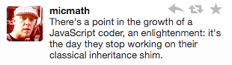
Prototypal Inheritance
JavaScript is a class-free, object oriented language
Inheritance is via prototypes, not classes
A prototype is an object from which other objects inherit properties
Any object can be a prototype
Every object has a prototype except the top-level Object
__proto__ is a way to access an object's prototype
"I have learned to fully embrace prototypalism, and have liberated myself from the confines of the classical model." -- Douglas Crockford

Slide 106
Prototype Example
function Parent() {
this.whoami = 'parent';
}
Parent.prototype = {
speak: function() {
console.log('Hello');
}
};
// Child will inherit from Parent
function Child() {}
// Set Child's prototype to a new instance of Parent
Child.prototype = new Parent();
Child.prototype.bye = 'Goodbye';
var son = new Child(); // create an instance
console.log(son instanceof Child); // true
console.log(son instanceof Parent); // true
son.speak(); // says 'Hello'
console.log(son.whoami); // 'parent'

Slide 107
Inheritance - Property/Method Lookup
Looks first at specific object son.hasOwnProperty(whoami)==false
Looks to up the prototype chain Child.hasOwnProperty(whoami)==false Parent.hasOwnProperty(whoami)==true
Continues till it reaches Object, the prototype of all objects. If not there, returns undefined
function Parent() {
this.whoami = 'parent';
}
Parent.prototype = {
speak: function() {
console.log('Hello');
}
};
function Child() {}
Child.prototype = new Parent();
var son = new Child();
console.log(son.whoami);
console.log(son.foo); // undefined

Slide 108
Parasitic Inheritance
var Person = function(name, age) {
this.name = name;
this.age = age;
};
var Employee = function(name, age, group) {
var e = new Person(name, age);
e.group = group;
return e;
};
var alex = new Employee('Alejandro', 25, 'Developer');
Simple pattern for inheritance in JavaScript

Slide 109
MODULES

Slide 110
CommonJS
Standard way to create self-contained, exportable functionality. See commonjs.org for the spec.
Goals:
Private scope within the module
Explicitly exported API
Decoupling and reusability
Inside a module, exports is an object to which you can attach properties
You can replace that object by setting module.exports
Modules "imported" with the require() global function

Slide 111
Helper / Library Pattern
// file is network.js
exports.getData = function() {
// get data from the network
};
exports.postData = function() {
// post data to the network
};
//equiv
// file is network.js
exports.getData = getdata;
exports.postData = postdata;
var getdata = function(){};
var postdata = function(){};
// how to use it
var net = require(‘network'); // no '.js'!!
var someData = net.getData();
button.addEventListener('click', function() {
net.postData(someData);
});

Slide 112
Factory Pattern
// file is Button.js
// creates a UI component we'll need many copies of
var Button = function(title) {
return Ti.UI.createButton({ title: title });
};
module.exports = Button; // return the constructor
// how to use it
var Button = require('ui/Button');
// now make some instances
var button1 = new Button('foo');
var button2 = new Button('bar');

Slide 113
Modules in Titanium
Caching — module isn't re-evaluated with subsequent require()'s
Omit leading '/' ... require('ui/somemodule')
Paths are relative to Resources directory
Pass in live data the module will need (e.g. a user object)
Require in any libraries/modules the module will need (e.g. your database module)
In Titanium, a module has access to its parent's global object -- but don't count on it

Slide 114
BEST PRACTICES

Slide 115
Code for Readability
Naming variables and objects
Spacing and indentation
Pass {} rather than a list of arguments
Comments
'
var a; // not so good
var object_user_level_superadmin; // ugh
var admin; // Goldilocks!
myFunc(1, 2, 1, 3); // unclear
myFunc({
height: 1, width: 2, left: 1, right: 3
}); // much clearer

Slide 116
Garbage Collection
Automatic via "mark & sweep“
Objects collected when no references remain
Nothing in the global space is ever collected!
"Force" collection by encapsulating within functions or modules that will go out of scope

Slide 117
Avoiding Memory Leaks
Don't store variables in the global scope
Set objects = null when no longer needed
Watch for "hidden" references in functions, closures, event listeners, accidental global assignments
Profile your app

Slide 118
Performant Coding
Defer execution — load modules as needed & don't Ti.include() code
Modules cache code so it's not re-evaluated
Avoid the global scope
Use closures sparingly
Avoid eval() and implicit evals
Don't change data types stored in a variable

Slide 119
Performant Loops
Set upper bound before loop
For/in loops slower than for or while
Define local references
Operators a little faster than functions'
// with arr.length = 10000
for(var i=0, j=arr.length; i < j; i++) {}
// is faster than
for(var i=0; i < arr.length; i++) {}
var foo = bar.someproperty.anotherproperty
while(foo < 10) { }
// faster than
while(bar.someproperty.anotherproperty < 10) { }
for(var i=0; i < 100; i++) {
someVal = (a < b) ? a : b;
// is a tiny bit faster than
someVal = Math.min(a,b);
arr[arr.length] = newMember
// is faster than
arr.push(newMember)
}

Slide 120
Summary
In this lesson, you:
Examined JavaScript language basics
Gained an understanding of variables and scope
Learned how to create and use functions
Learned how to create and use objects and manage inheritance
Examined CommonJS modules
Examined code that implements JavaScript best practices

Slide 121
Q&A

Slide 122
Lab Objectives
In this lab, you will:
Take the "JavaScript Scope Quiz" http://madebyknight.com/javascript-scope/
Homework: Take Baranovskiy’s JavaScript quiz http://dmitry.baranovskiy.com/post/91403200 See www.nczonline.net/blog/2010/01/26/answering-
baranovskiys-javascript-quiz/ for answers
Homework: Work through John Resig's Learning JavaScript tutorial http://ejohn.org/apps/learn/
Tips: Use http://jsbin.com/ with the HTML pane off; and JavaScript, Console, & Output panes on to test code

Slide 123
User Interface
Titanium Certified DevelopER (TCD) Training

Slide 124
In this lesson, you will:
Explore the components used to create your UI
Learn your options for UI layout and component positioning
Handle user and non-user generated events
Learn how to set your app's icon & splash screens, and internationalize your app

Slide 125
UI COMPONENTS

Slide 126
Controls
Windows and Views
Labels
ImageViews
Buttons, Text Fields, Text Areas
Navigation controls -- tabs, split windows, etc.
Media-related (video or audio players)

Slide 127
Windows & Views
'Containers' to hold other components
Windows = full screen (usually)
Views = portion of the screen (like a <div>)
Every app has at least one window

Slide 128
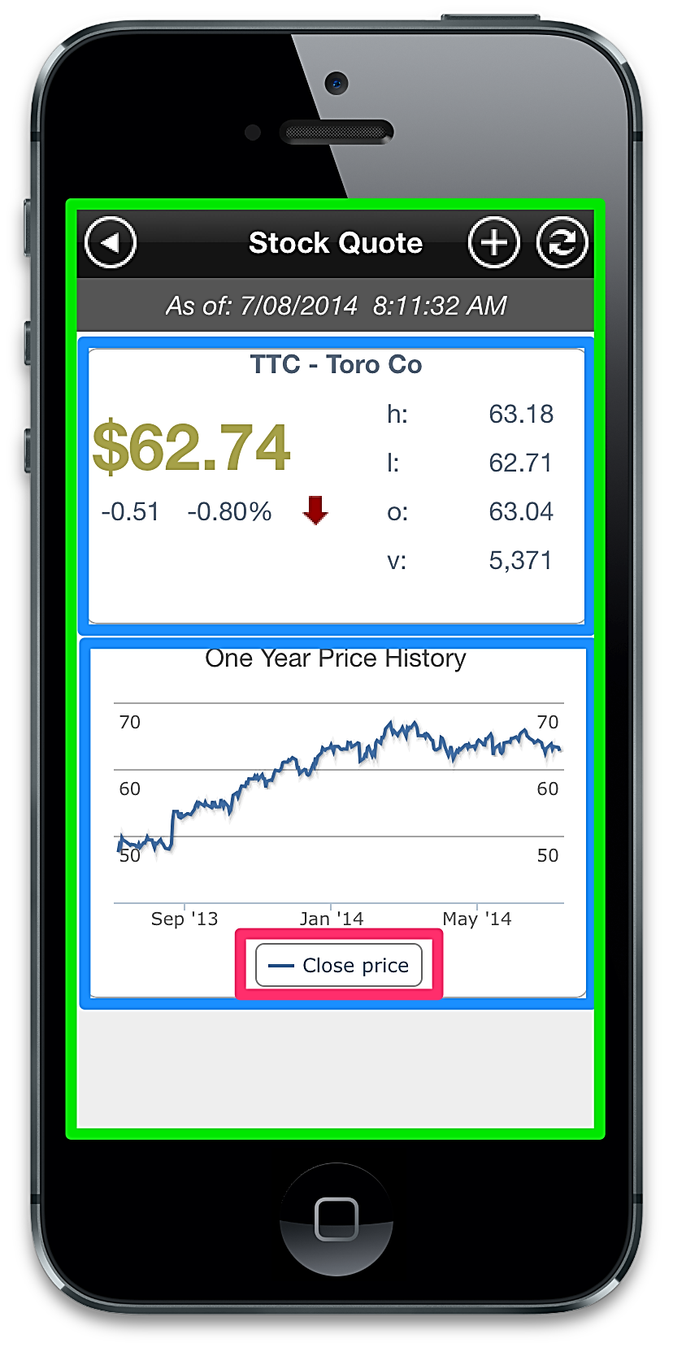
View Hierarchy - Window-based apps
Single window (no tabs)
Views inside window or other views
<Alloy>
<Window>
<View>…</View>
<View>
<Button />
</View>
</Window>
</Alloy>

Slide 129
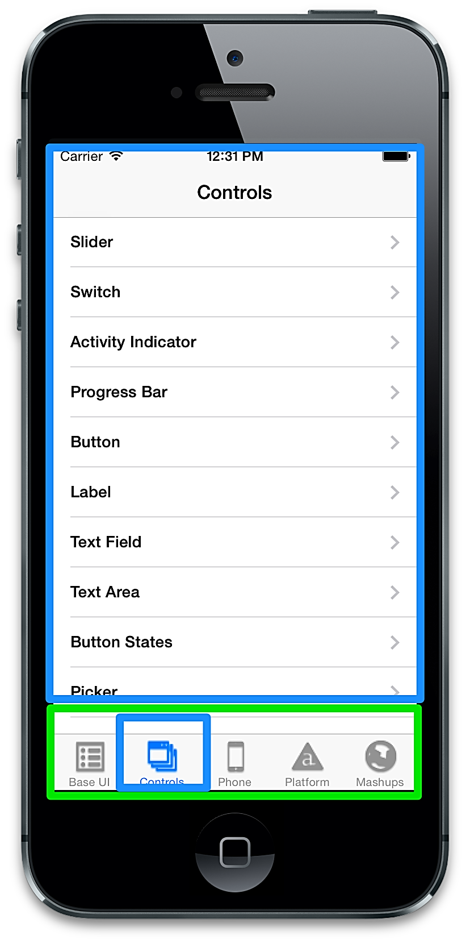
View Hierarchy - Tab-based apps
Tab group with 1+ tabs
Each tab has one window
Views inside window or other views
<Alloy>
<TabGroup>
<Tab>
<Window><View></View></Window>
</Tab>
</TabGroup>
</Alloy>

Slide 130
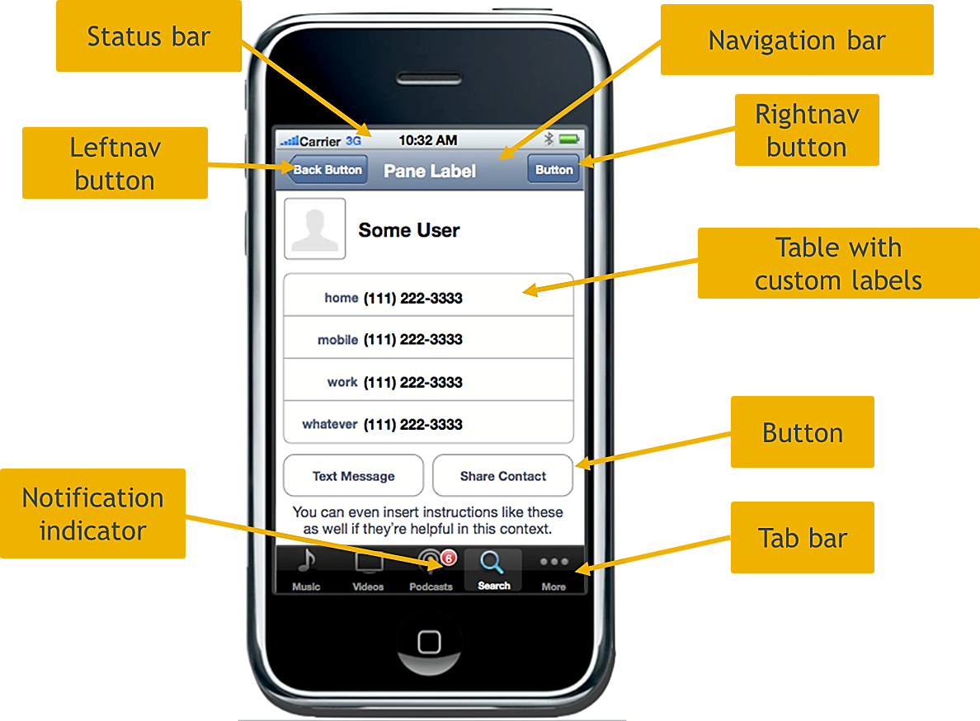
iOS 6 UI Components

Slide 131
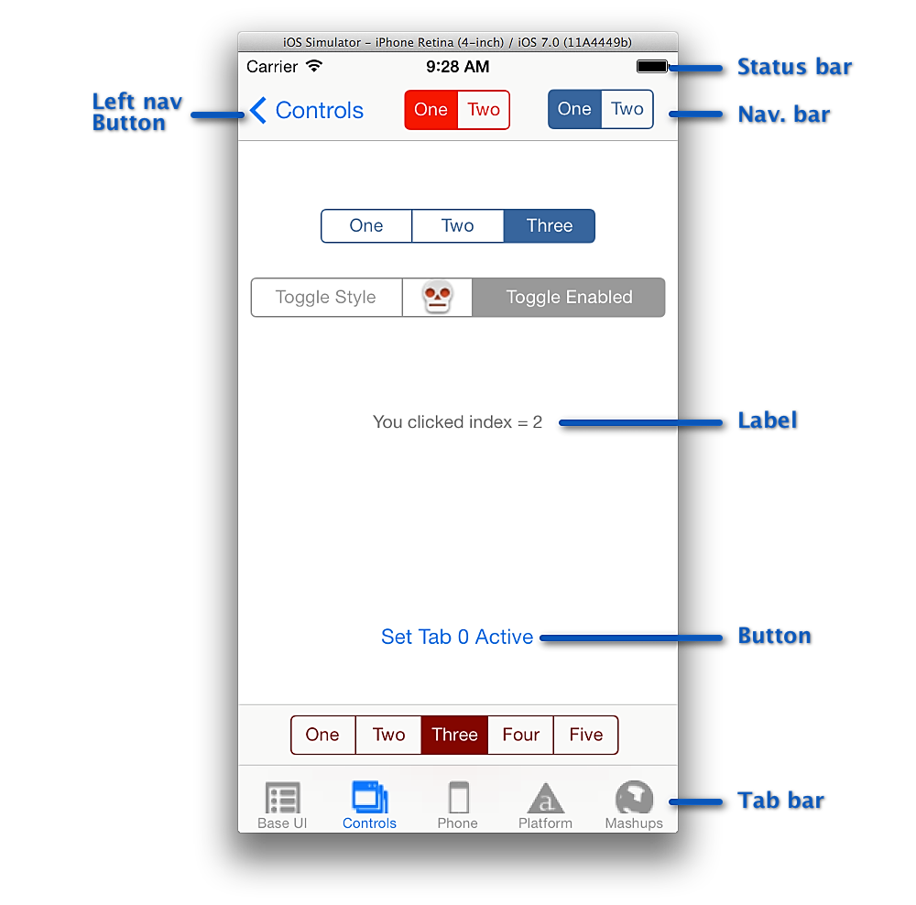
iOS 7 UI Components

Slide 132
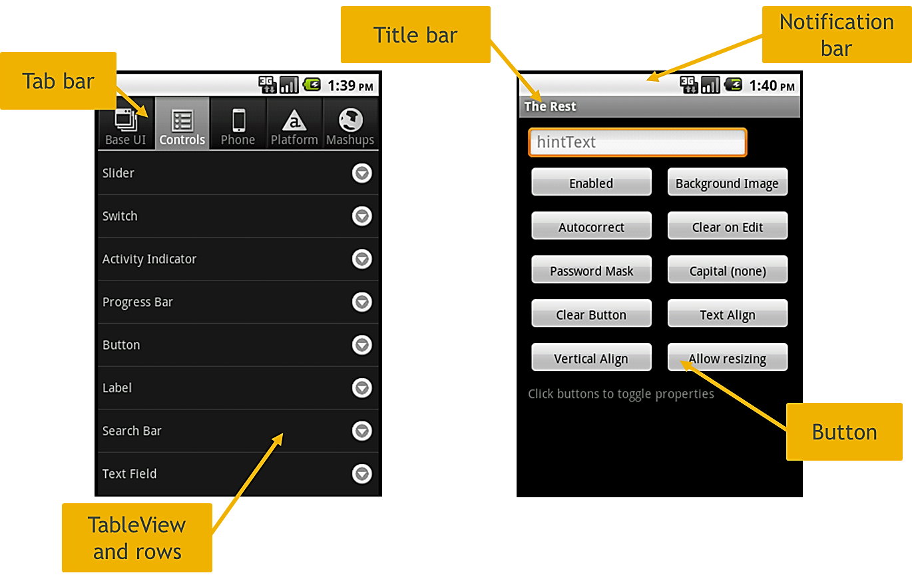
Android 2.x User Interface Components

Slide 133
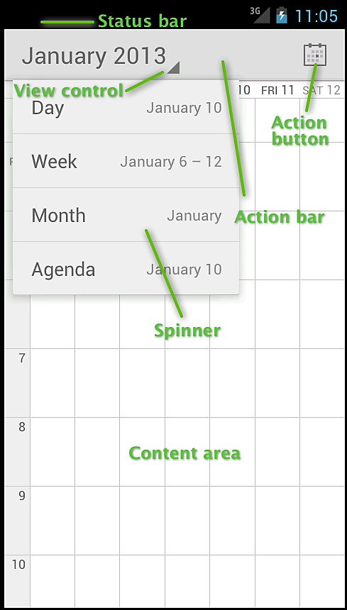
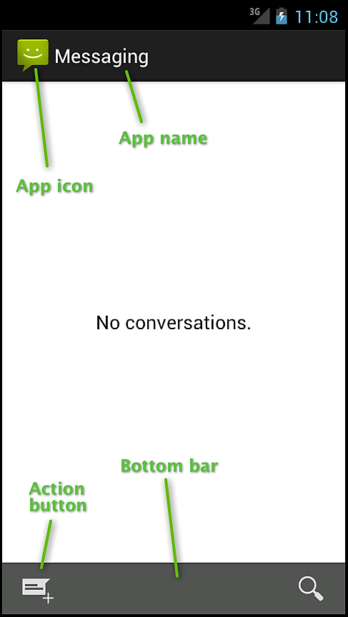
Android 4.x User Interface Components

Slide 134
TRY
In Studio, create a new Titanium Mobile project.
Examine the view hierarchy in app/views/index.xml
Identify the containers in the view hierarchy of this app

Slide 135
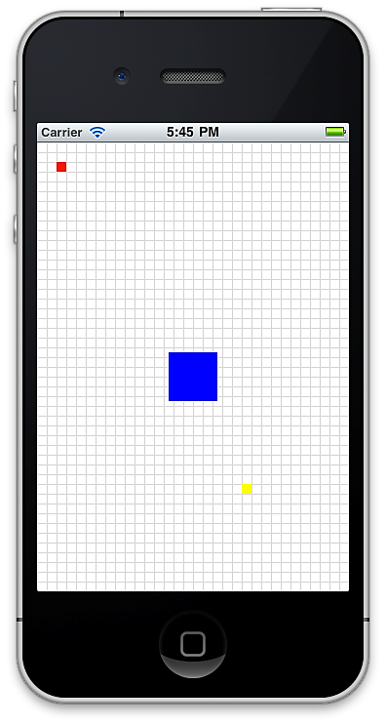
Positioning
<View id=“red” />
<View id=“blue” />
<View id=“yellow” />
“#red”:{
top: 10, left: 10,
width: 10, height: 10
},
“#blue”:{
center:{x:50%,y:50%}, width: 50, height: 50
},
“#yellow”:{
bottom:70, right: 70,
width: 10, height: 10
}
top and left
bottom and right
center
Notes:
----- Meeting Notes (6/23/14 14:19) -----
Chnage to show a tss

Slide 136
Units
Absolute measurements: px (pixels), dp/dip, mm, cm, in
Relative measurements: % = percent of the parent's height or width
var view = Ti.UI.createView({
/* You would not normally mix units like this */
top: '10mm',
left: '5px',
width: '30%',
height: 50 /* default system units are used here */
});
Default units - on Android = pixels; on iOS = dip

Slide 137
Auto' Behaviors
You can use Ti.UI.SIZE or Ti.UI.FILL instead of actual height/width value
SIZE: fits to contents
FILL: fills parent
Defaults (if you don't set a height/width)
Buttons, labels, images, text fields and areas = Ti.UI.SIZE
Windows, views, tables, webviews = Ti.UI.FILL
Table rows = FILL for width and SIZE for height

Slide 138
Coordinates Grid
iPhone 3/4 - 320 by 480 point grid
iPhone 5 - 320 by 568 point grid
iPad 1/2/3 - 1024 by 768 grid
Android sizes vary:
HVGA = 320 by 480 px
WVGA800 = 480 by 800 px
WVGA854 = 480 by 854 px

Slide 139
Layout modes
Absolute
Vertical
Horizontal

Slide 140
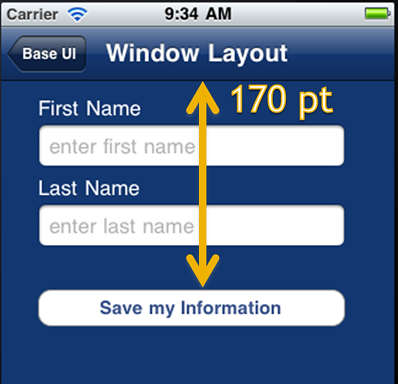
Absolute Layout
<Button id=“SaveBtn”>Save my Information</Button>
---
“#SaveBtn”:{
top: 170
right: 20,
width: 280
…

Slide 141
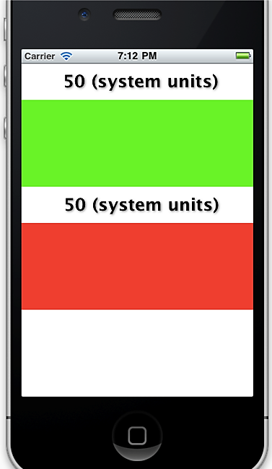
Vertical Layout
“Window”:{
layout: “vertical”
},
“#green”:{
top: 50,
backgroundColor: ‘green’
height: 120
},
“#red”:{
top: 50,
backgroundColor: ‘red’
height: 120
}

Slide 142
TRY
To the sample project you began earlier, change the Window to vertical layout.
Create a view and add it to the window. Make the view 120 units tall and 50 units from the top. Set its background to be green
Create a second view with the same properties, though with a red background. Add it to the window
Build your project. Does the screen roughly match the preceding slide?

Slide 143
EVENTS

Slide 144
Event Handling
Events are things that happen that you can monitor and react to
User-generated: clicks, swipes, shakes, etc.
Custom: non-user events that you use to signal within your app
System-generated: battery low, phone call or SMS received

Slide 145
Event Handling, cont'd
Event listener - code you 'attach' to something to run when an event occurs
Firing event - causing an event so that listeners are engaged
You can add a listener on any UI component
You can add custom listeners to nearly any object in your app
You can fire any user-generated or custom type event (not the system events though)

Slide 146
Example 1
// let's start with a UI component, a button
var btn = Ti.UI.createButton({
title: 'Click me'
});
btn.addEventListener('click', function(e) {
alert('Ouch! You clicked me!');
});

Slide 147
Example 2
// let's start with a UI component, a button
<Button onClick=“ouch” id=“btn”>I am a button</Button>
// let's define our function first
function ouch() {
alert('Ouch! You clicked me!');
}
// then use it in the listener -- without the () !!
$.btn.addEventListener(‘click', ouch);

Slide 148
Removing Event Listeners
<Button id=“btn”>I am a button</Button>
function ouch() {
alert('Ouch! You clicked me!');
$.btn.removeEventListener('click', ouch);
$.btn.title = "You can't click me";
}
$.btn.addEventListener('click', ouch);

Slide 149
Event Object Properties
<TextField id=“textField”>
<TextField id=“anotherField”>
$.textField.addEventListener('change', function(e) {
// e represents the 'event' object
$.anotherField.value = e.value; // it has various properties
});

Slide 150
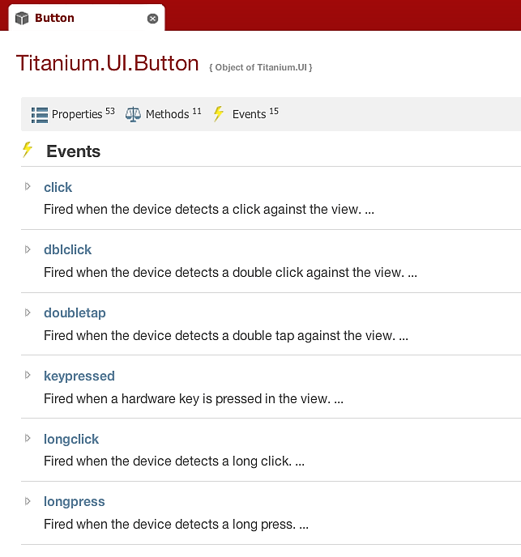
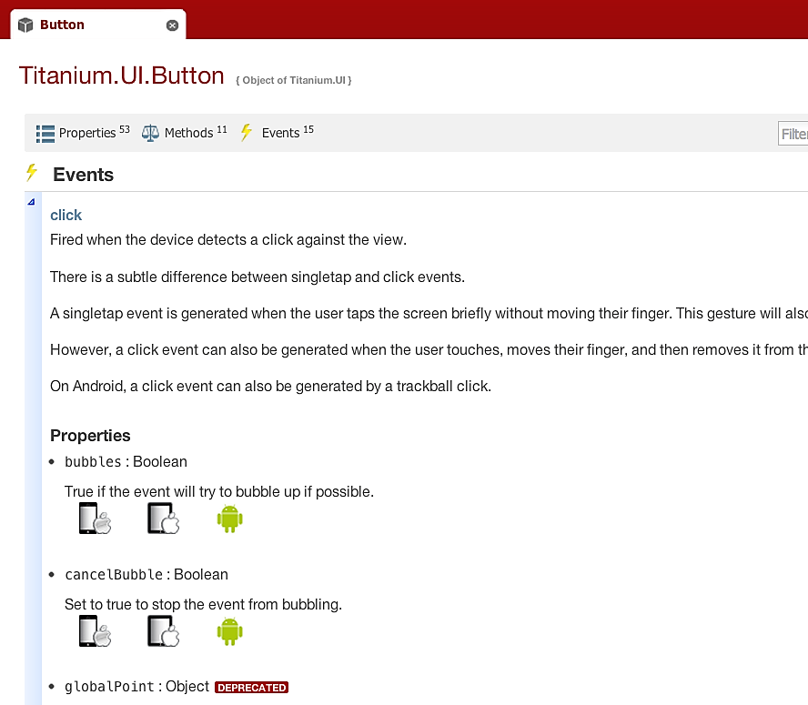
Events Documentation
docs.appcelerator.com

Slide 151
Application-Level Events
Not associated with a UI component
Used for signaling within the application
Can be fired from and listened for from anywhere within your app

Slide 152
App Events Example
function saveToDatabase() {
// code goes here to save info
// to the database, when it's
// done, fire app event
Ti.App.fireEvent('databaseUpdated');
}
<TableView id=“table” />
Ti.App.addEventListener('databaseUpdated', function() {
$.table.data = db.getInfoAsTableRows();
});

Slide 153
TRY
Add a click event listener to the first view.
When the user clicks on the view, display an alert message using alert()
Build your project to test your work

Slide 154
ICONS, LAUNCH SCREENS, i18n

Slide 155
App icons - iOS
 | iPhone |  | iPad
 | iOS6 | iOS7 | iOS6 | iOS7
Non-retina | appicon.png (57px) | appicon-60.png (60px) | appicon-72.png (72px) | appicon-76.png (76px)
Retina | appicon@2x.png (114px) | appicon-60@2x.png (120px) | appicon-72@2x.png (144px) | appicon-76@2x.png (152px)
Place in:
Alloy: app/assets or app/assets/iphone

Slide 156
App icons - Android
Simple solution: place a single appicon.png in app/assets, or app/assets/android. Or:
Class | Dimensions and DPI | File name and path
ldpi | 120 dpi, 36x36 px | /platform/android/res/drawable-ldpi/appicon.png
mdpi | 160 dpi, 48x48 px | /platform/android/res/drawable-mdpi/appicon.png
hdpi | 240 dpi, 72x72 px | /platform/android/res/drawable-hdpi/appicon.png
xdpi | 320 dpi, 96x96 px | /platform/android/res/drawable-xdpi/appicon.png
xxdpi | 480 dpi, 144x144 px | /platform/android/res/drawable-xxdpi/appicon.png

Slide 157
Launch Screens - iOS
iOS
Default.png | Non-retina iPhone/iPod | 320x480
Default@2x.png | Retina iPhone/iPod | 640x960
Default-568h@2x.png | iPhone 5/iPod 5 | 640x1136
Default-Landscape.png & Default-Portrait.png | Non-retina iPad | 1024x768
Default-Landscape@2x.png & Default-Portrait@2x.png | Retina iPad | 2048x1536
Alloy: app/assets or app/assets/iphone

Slide 158
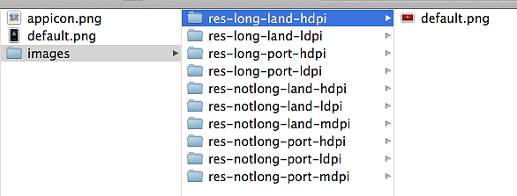
Launch Screens - Android
Option 1: Use a single default.png in app/assets/android Will be stretched to fit screen size and proportions
Option 2: Put size/resolution-specific versions of default.png in res directories No tablet sizes supported
Option 3: Use a 9-patch image (See http://goo.gl/P950R)

Slide 159

Internationalization

Slide 160



Using the strings
L() is an alias for Ti.Platform.getString()

Slide 161
Extracting Strings
// Shows a before and after of your i18n file, does NOT write the changes
$ alloy extract-i18n
// Writes the changes to "i18n/en/strings.xml"
$ alloy extract-i18n --apply
// Specify a different language with another parameter ("en" is the default)
$ alloy extract-i18n es
// Specify "es" as the language and write the changes to "i18n/es/strings.xml"
$ alloy extract-i18n es --apply

Slide 162
i18n Notes
i18n directory goes in project root, not inside app or Resources!
Language directories named with ISO-639 two-letter country codes
You have to create those directories yourself
Which strings are shown depends on device's language setting ...not for user-switchable language selection within your app
The XML structure matches Android's string resources file, mapped to plist on iOS at build time

Slide 163
Summary
In this lesson, you:
Learned the roles of UX and UI design
Explored the components used to create your UI
Learned your options for UI layout and component positioning
Learned how to set your app's icon & splash screens, and internationalize your app

Slide 164
Q&A

Slide 165
Lab Objectives
In this lab, you will:
Examine an app design, determine UI components needed
List the container and visual UI objects
Determine what graphic assets will be needed
Lab: wiki.appcelerator.org/display/td/04.+User+Interface

Slide 166


Create a default project
Run it in the simulator/emulator using both Studio and the CLI
Configure app and run-time options
Lab: Appecelerator Wiki > TCD > 03 – Titanium Basics
wiki.appcelerator.org/display/td/03.+Titanium+Basics
LAB
SOLUTION WALK THRU
Notes:
Lesson time: 90 mins
30 mins lab
Please use your best judgment as an instructor — set the pace of this lesson according to your students' JavaScript skills. You might consider skipping some slides for advanced audiences or spending extra time with a more novice group of students.

Slide 167
Alloy Overview
Titanium Certified DevelopER (TCD) Training

Slide 168
In this lesson, you will:
Identify the role of the Alloy MVC components
Implement a UI control using Views and Styles
Enable interactivity with a Controller
Identify options for handling platform differences in Alloy

Slide 169
ALLOY OVERVIEW

Slide 170
Overview & Goals
MVC separates form and function
Speed and simplify development
Improve maintainability
Alloy is Appcelerator's MVC-like framework for Titanium

Slide 171
Alloy MVC
Views
Styles
Controllers
Models
Extras

Slide 172
View - index.xml
<Alloy>
<Window id=“mainwin” class="container">
<Label id=”myLabel”>Hello, World</Label>
</Window>
</Alloy>

Slide 173
Styles -- <file>.tss
".container": {
backgroundColor: "white"
},
"Tab" : {
icon: '/images/fugitives.png',
},
"Window": {
backgroundColor : 'transparent',
backgroundImage : 'images/grain.png',
title: 'Fugitives',
barColor: '#6d0a0c',
},
'#table' : {
backgroundColor: 'transparent'
}

Slide 174
Controllers
function doClick(e) {
alert($.label.text);
}
$.index.open();

Slide 175
Models
exports.definition = {
config : {
"columns" : {
"name" : "string",
"captured" : "integer",
"url" : "string",
"capturedLat" : "real",
"capturedLong" : "real"
},
"adapter" : {
"type" : "sql",
"collection_name" : "fugitives"
}
},
...
}

Slide 176
Convention over Configuration
File/Directory | Contents & Purpose
/app/config.json | Specify global values, conditional environment and operating system values, and widget dependencies.
/app/views | XML View files
/app/styles | TSS Style files
/app/controllers | JavaScript Controller files
/app/models | JavaScript Model files
/app/migrations | JSON files that describe incremental changes in your database; in the formatDATETIME_modelname.json
/app/assets | Graphic, data file, and other app assets; not created by default.
/app/lib | App-specific library files; not created by default.
/app/themes | Theme files and assets to customize your UI; not created by default.
/app/widgets | Files and assets associated with widgets (self-contained app components)

Slide 177
Create a default project
Run it in the simulator/emulator using both Studio and the CLI
Configure app and run-time options
Lab: Appecelerator Wiki > TCD > 03 – Titanium Basics
wiki.appcelerator.org/display/td/03.+Titanium+Basics
LAB
ALLOY APP WALK THRU
Notes:
Use any application you might have available or use the one that you create in the previous lab to demonstrate all the folders available in an alloy app.

Slide 178
ALLOY VIEW & STYLES IN DETAIL

Slide 179

View tag
// view file
<Alloy>
<ImageView id='foo' image='foo.png'/>
</Alloy>
// style file
"#foo": {
height:Ti.UI.SIZE,
width: Ti.UI.SIZE
}

Slide 180
Require
Break up views into multiple files
<Alloy>
<TabGroup id='tabGroup'>
<!-- Tab included via <Require> tag -->
<Require type="view" src="fugitives" id="fugitivetab"/>
<!-- Tab included via <Require> tag -->
<Require type="view" src="captured" id="capturedtab" customVar="foo"/>
</TabGroup>
</Alloy>

Slide 181
Namespaces
// for objects not in Ti.UI namespace, such as Ti.Map.View:
<View ns="Ti.Map" id="map"/>
// for objects in sub-namespaces, such as Ti.UI.iOS.NavigationGroup:
<NavigationGroup platform="mobileweb"/>
Create elements not in the Ti.UI namespace:

Slide 182
Style Files
Component, class, and ID
Global app.tss
Constants
i18n functions
Alloy globals
".activeButton": {
backgroundColor:"blue"
},
"Button": {
width: Ti.UI.SIZE,
height: Ti.UI.SIZE,
color: "#000"
},
"#iosBtn": {
color: "#999",
systemButton: Titanium.UI.iPhone.SystemButton.DISCLOSURE,
title: L('iosbutton'),
left: Alloy.Globals.computedWidth
}

Slide 183
Styles Generation
Create or update the TSS for a controller
// at a command prompt/terminal:
alloy generate style controller_name
// generate TSS for all controllers
alloy generate style --all

Slide 184
Dynamic Styling
Add/remove classes to components
Create style objects at run-time
Dynamic styling is not enabled by default
Enable with autoStyle property
// for individual component
<View autoStyle="true">
// for all components in controller
<Alloy autoStyle="true">
// for whole project, set in config.json
{
"autoStyle": false
}

Slide 185
Dynamic Styles - Add/remove Classes
// $.button is a Ti.UI.Button in this controller
// now add classes to the button
$.addClass($.button, 'my_TSS_class another_class some_other_class');
// remove a class
$.removeClass($.button, 'some_other_class');
// reset styles, then apply a class
$.resetClass($.button, 'my_TSS_class');
myWindow.getView().open();

Slide 186
Dynamic Styles - Create a Style object
// $.button is a Ti.UI.Button in this controller
var style = $.createStyle({
classes: 'my_TSS_class',
apiName: 'Button', /* or Ti.UI.Button */
color: 'blue' /* optional, explicit property to set */
});
$.button.applyProperties(style);

Slide 187
TRY
Examine the View files used by the AlloyHunter app to identify the UI components that are being defined.
Examine the Style files to correlate the components with their style selectors

Slide 188
CONTROLLERS IN DEPTH

Slide 189
Controllers
Contain the application logic
Communicate between Views and Models
Handle user interaction and dynamic UI updates
Access components via their id attribute: $.<idstring>

Slide 190
Views without IDs
// index.xml
<Alloy>
<Window class="container” >
<Label id="label" onClick="doClick">Hello, World</Label>
</Window>
</Alloy>
// in index.js
// Window tag has no id, so access by file name
$.index.open();
// in a view
<Window class="container" id="mainwin">
<Label id="label" onClick="doClick">Hello, World</Label>
</Window>
</Alloy>
// in index.js
// Window tag has an id, so $.index.open() would fail!
$.mainwin.open();

Slide 191
Event Handling
/* listening for an event on a Ti object with id of 'button' */
$.button.addEventListener('click', function(e){
// do something
});
// firing an event
$.button.fireEvent('click', {foo: 'bar'});
// adding and removing an event
var listener = function() {
Ti.API.info("Event listener called.");
}
$.win.addEventListener('click', listener);
$.win.removeEventListener('click', listener);

Slide 192
Dynamically Creating Views
Alloy.createController -- factory method for instantiating a controller
Controller.getView -- return the view associated with this controller
// controller file something like index.js
// we're dynamically loading and showing some other view
var foo = Alloy.createController(‘foo’).getView();
foo.open();

Slide 193
Dynamic Views Example
Using custom rows in a tableview
var rows = [];
// arr is some array of data to show in a table
for (var i = 0; i < arr.length; i++) {
var row = Alloy.createController('CustomRow', arr[i].toJSON()).getView();
rows.push(row);
}
// set the table
$.table.setData(rows);

Slide 194
Passing Arguments
Pass arguments when initializing a controller
//index.js
var data[];
for (var i=0; i < source.length; i++) {
var arg = {
title: source[i].postTitle,
url: source[i].postLink
};
var row = Alloy.createController('row', arg).getView();
data.push(row);
}
$.tableView.setData(data);
//row.xml
<Alloy>
<TableViewRow id="rowView">
<Alloy>
//row.js
var args = arguments[0] || {};
$.rowView.title = args.title || '';
$.rowView.url = args.url || '';

Slide 195
TRY
Examine the Fugitives.js controller:
the dynamically-created view in addNewFugitive()
the event listener
the arguments passed to the dynamic view within the listener
Examine the FugitiveDetails.js controller:
accessing the arguments
and how that argument's data is used throughout

Slide 196
PLATFORM HANDLING

Slide 197
Platform & Form Factor
App assets
Conditional code
Markup-based Techniques
TSS-based Qualifiers
Platform Build-time Folders

Slide 198

Asset Folders

Slide 199
Conditional Code
OS_IOS, OS_ANDROID, OS_MOBILEWEB
ENV_DEV, ENV_TEST, ENV_PRODUCTION
if (ENV_DEV && OS_IOS) {
alert("You are running iOS in the simulator");
}

Slide 200
Platform and Device Markup
<Alloy>
<Window class="container">
<View formFactor="handheld">
<Label>I'm a handheld!</Label>
</View>
<View formFactor="tablet">
<Label>I'm a tablet!</Label>
</View>
<View height="50" width="200" bottom="10" backgroundColor="#cdcdcd">
<Label class="platformLbl" platform="android" formFactor="tablet">android tablet</Label>
<Label class="platformLbl" platform="android" formFactor="handheld">android handset</Label>
<Label class="platformLbl" platform="ios" formFactor="tablet">ios tablet</Label>
<Label class="platformLbl" platform="ios" formFactor="handheld">ios handset</Label>
</View>
</Window>
</Alloy>

Slide 201
TSS-based Qualifiers
"#mybutton[platform=android]" : {
height:'40dp',
},
"#mybutton[platform=ios]" : {
height:50,
},
"#osLabel[platform=ios formFactor=tablet]": {
text: "iPad"
},
"#osLabel[platform=ios formFactor=handheld]": {
text: "iPhone"
},

Slide 202

Platform Overrides

Slide 203
Configurations
// config.json file
{
"global": { "foo": 1},
"env:development": {},
"env:test": {},
"env:production": {},
"os:ios": { "foo": 2 },
"os:android": {},
"dependencies": {}
}
// in your code
alert(Alloy.CFG.foo); // value is 1 or 2 depending on OS

Slide 204
Themes
Named collection of styles and assets
Applied via setting in the config.json file (can be platform-specific)
Theme settings override base styles and assets
Overrides are made on an attribute by attribute basis, not whole files
app/
assets/
appicon.png
background.png
styles/
app.tss
index.tss
themes/
mytheme/
assets/
background.png
styles/
app.tss
green/
...

Slide 205
TRY
Examine the conditional code in Fugitives.js and FugitiveDetails.js
Examine platform selectors in FugitiveDetails.tss
Compare the graphic assets for Android and iOS

Slide 206
Alloy vs. “Traditional”
It's not all or nothing — Ti.UI.createView() and its brethren still valid
API techniques used within the controllers, in helper libraries (network, database, etc.)
Alloy is essentially a pre-compiler
In the end, Alloy creates traditional code for you — check out the Resources folder!

Slide 207
Summary
In this lesson, you:
Identified the role of the Alloy MVC components
Implemented a UI control using Views and Styles
Enabled interactivity with a Controller
Identified options for handling platform differences in Alloy

Slide 208
Q&A

Slide 209
Lab Objectives
Create an Alloy-based project
Implement app functionality with Views, Styles, and Controllers
Lab: wiki.appcelerator.org/display/td/05.+Alloy

Slide 210
Create a default project
Run it in the simulator/emulator using both Studio and the CLI
Configure app and run-time options
Lab: Appecelerator Wiki > TCD > 03 – Titanium Basics
wiki.appcelerator.org/display/td/03.+Titanium+Basics
LAB
SOLUTION WALK THRU
Notes:
Lesson time: 90 mins
30 mins lab
Please use your best judgment as an instructor — set the pace of this lesson according to your students' JavaScript skills. You might consider skipping some slides for advanced audiences or spending extra time with a more novice group of students.

Slide 211
AGENDA – Day 2
Models & Collections
Networking
Multimedia
Filesystem
Geolocation & Mapping

Slide 212
Models & Collections
Titanium Certified DevelopER (TCD) Training

Slide 213
In this lesson, you will:
Explore Alloy's implementation of Backbone's Models & Collections
Represent your app's data via Models and Collections
Bind Models and Collections to Views
Save data locally and remotely via sync adapters
Explore migrations to update models to new schema
Explore API (non-Alloy) techniques for saving data to properties and local database

Slide 214
MODELS & COLLECTIONS

Slide 215

Models/Collections based on Backbone
subheadline
Backbone.js is an MVC framework for web development
Alloy's models/collections are based on the Backbone's classes
Requires Underscore.js (so it's included in Alloy projects)

Slide 216
Models
Encapsulate the data and state of your app
Define data-related rules (defaults, validation, etc.)
Define where and how that data is persisted
Define data-transformation logic ("business logic")
// File: app/models/book.js
exports.definition = {
config: {
"columns": {
"title":"text",
"author":"text",
"isbn":"text"
},
"adapter": {
"type": "sql",
"collection_name": "book"
}
}
}

Slide 217
Collections
Groups of models
Created in the controller
There is no "models/mycollection.js" file
But you can customize within the model file
// File: app/controllers/someview.js
var library = Alloy.createCollection('book');
library.fetch(); // Grab data from persistent storage

Slide 218
Model Anatomy
// File: app/models/book.js
exports.definition = {
config: {
// table schema and adapter information
},
defaults: {
// default values for fields go here
},
extendModel: function(Model) {
_.extend(Model.prototype, {
// Put model validation and manipulation functions here
});
return Model;
},
extendCollection: function(Collection) {
_.extend(Collection.prototype, {
// Put collection validation and manipulation functions here
});
return Collection;
}
}

Slide 219
Accessing Model Data
// Define a model of type 'book'
var book = Alloy.createModel('book', {
title:'Green Eggs and Ham',
author:'Dr. Seuss'
});
// access the fields in our model
var title = book.get('title');
var author = book.get('author');
// Assuming a Ti.UI.Label object in the view with id = 'label'
$.label.text = title + ' by ' + author;
book.set('title', 'Cat in the Hat');
$.label2text = 'Also by ' + author + ', ' + title;

Slide 220
Accessing Model/Collection Data
function addItem() {
var books = Alloy.Collections.book;
// Create a new model for the books collection
var book = Alloy.createModel('book', {
author : $.authorField.value,
title : $.titleField.value,
isbn : $.isbnField.value
});
// add new model to the collection
books.add(book);
// save the model to persistent storage
book.save();
// reload the tasks
books.fetch();
closeWindow();
}

Slide 221
Extending Backbone.Model
exports.definition = {
config: {
// table schema and adapter information
},
extendModel: function(Model) {
_.extend(Model.prototype, {
// Implement the validate method
validate: function (attrs) {
for (var key in attrs) {
var value = attrs[key];
if (key === "title") {
if (value.length <= 0) {
return "Error: No title!";
}
}
}
},
// Extend Backbone.Model with a custom property and function
customProperty: 'book',
customFunction: function() {
Ti.API.info('I am a book model.');
},
});
return Model;
}
}

Slide 222
e.g. Extending Collections to Sort
// in our controller
var books = Alloy.Collections.books;
// force a sort() by title
books.sort();
// in our model
exports.definition = {
config: {
// schema and adapter info
},
extendModel: function(Model) {
_.extend(Model.prototype, {
});
return Model;
},
extendCollection: function(Collection) {
_.extend(Collection.prototype, {
// Implement the comparator method,
// which is used to sort the collection
comparator : function(book) {
return book.get('title');
}
}); // end extend
return Collection;
}
}

Slide 223
Model/Collection Events
Many Alloy (Backbone) operations fire events
Model events include: add, change, change:field_name, & error
Collection events include add, change, error, remove, reset, & sort
exports.definition = {
config: {
// table schema and adapter information
},
initialize: function(){
this.on("error", function(currentModel){
Ti.API.error('error!!');
});
},
extendModel: function(Model) {
_.extend(Model.prototype, {
// Implement the validate method
validate: function (attrs) {
// validation code here
},
...

Slide 224
TRY
Examine the models/Fugitive.js model
Identify the columns and default values

Slide 225
REPRESENTING APP DATA

Slide 226
Data types
SQLite: TEXT, INTEGER, REAL, BLOB
Alloy: text, string, varchar, int, tinyint, smallint, bigint, double, float, decimal, number, date, datetime and boolean
Map logically (int, tinyint, etc. → INTEGER)
Unknown types map to TEXT

Slide 227
Example
// File: app/models/book.js
exports.definition = {
config: {
"columns": {
"title":"text",
"author":"text",
"isbn":"text",
"price": "integer",
"publishDate": "date"
},
"adapter": {
"type": "sql",
"collection_name": "book"
}
}
}

Slide 228
Custom Queries
function showColorInfo(e) {
var color = e.row.model.color;
var collection = Alloy.createCollection('color');
// fetch color info from the color collection based on the
// given color from the user model
collection.fetch({
query: 'SELECT * FROM colors WHERE color = "' + color + '"'
});
...
Notes:
prepared statement or parameterized statement is a feature used to execute the same or similar database statements repeatedly with high efficiency.
Typically used with SQL statements such as queries or updates, the prepared statement takes the form of a template into which certain constant values are substituted during each execution.
Prepared statements are resilient against SQL injection. This is mostly a concern if the variables you are populating are coming from an outside source.

Slide 229
Custom Queries (Prepared Statements)
function showColorInfo(e) {
var color = e.row.model.color;
var collection = Alloy.createCollection('color');
// fetch color info from the color collection based on the
// given color from the user model
collection.fetch({
query: {
statement: 'SELECT * FROM colors WHERE color = ?',
params: [color]
}
});
...

Slide 230
Underscore methods
Alloy includes the underscore.js library
Use its methods to provide group-by and other data selection techniques
See http://underscorejs.org/#collections
_.each(yourCollection, someFunction);
_.sortBy(yourCollection, fieldName);
_.groupBy(yourCollection, fieldName);

Slide 231
Installing a Pre-built Database
exports.definition = {
config: {
"columns": {
"name":"text",
"nickname":"text"
},
"adapter": {
"type": "sql",
"collection_name": "fighters",
// Pre-load the database (safe method)
"db_file": "fighters.sqlite",
// db_name required when pre-loading a db
// should the name of your pre-loaded db
"db_name": "fighters"
// default primary key is alloy_id
// specify your own unique ID field with
"idAttribute": "id"
}
}
}

Slide 232
BINDING MODELS & COLLECTIONS TO VIEWS

Slide 233
Binding
Bind a collection to a TableView or View object
Bind a model to a component (i.e. button)
Alloy monitors add(), destroy(), remove(), change(), and fetch() methods and updates the view
Accomplished in View XML rather than controller… still need to fetch.

Slide 234
Example
// in the View
<Alloy>
<Collection src="books" />
<Window class="container">
<TableView dataCollection="books">
<!-- Also can use Require -->
<TableViewRow title="{title}" />
</TableView>
</Window>
</Alloy>

Slide 235
Releasing the model binding
// in the View
<Alloy>
<Collection src=“movies"/>
<Window id="moviesWin">
<TableView dataCollection="movies">
<TableViewRow title="{title}"/>
</TableView>
</Window>
</Alloy>
// in the controller
$.moviesWin.addEventListener('close', function() {
// make sure to call $.destroy() when you are done with the
// controller/window. This will ensure that no memory is
// leaked and that the bindings are properly released.
$.destroy();
});
Alloy.Collections.movies.fetch();

Slide 236
TRY
Examine Fugitives.xml to identify the collection being bound
Examine FugitiveRow.xml to see the fields being output
Examine the table event listener in Fugitives.js. Identify what _e.rowData.model refers to and where that value is defined.

Slide 237
SYNC ADAPTERS (SAVING DATA)

Slide 238
Saving a Model
function addItem(itemname) {
var todos = Alloy.Collections.todo;
// Create a new model for the todo collection
var task = Alloy.createModel('Todo', {
item : itemname,
done : 0
});
// add new model to the global collection
todos.add(task);
// save the model to persistent storage
task.save();
// reload the tasks
todos.fetch();
}

Slide 239
Sync Adapters
'sql' - SQLite database on iOS/Android
'localStorage' - HTML5 Local Storage on Mobile Web
'properties' - application properties
Specify in the model
Purpose of collection_name varies
// File: app/models/book.js
exports.definition = {
config: {
"columns": {
"title":"text",
"author":"text",
"isbn":"text"
},
"adapter": {
"type": "sql",
"collection_name":
"book"
}
}
}

Slide 240
Custom Sync Adapters
Community contributions: ACS, Dual-storage (local & remote), and more
Model/Collection methods implement RESTful calls
Define in a JavaScript file in either app/assets/alloy/sync or app/lib/alloy/sync
See docs for more info: http://goo.gl/XTn9O

Slide 241
MIGRATIONS

Slide 242
Migrations
Stored in app/migrations/
File name: YYYYMMDDHHMMSS_model.js e.g. 20120610049877_book.js.
You must have the same new columns/defaults in the model and migration file

Slide 243
Migration - Example
migration.up = function(db) {
db.createTable({
"columns": {
"book": "text",
"author": "text",
"isbn": "integer" /* our new field */
},
"defaults": {
"isbn": "0"
},
"adapter": {
"type": "sql",
"collection_name":
"books"
}
});
};
migration.down = function(db) {
db.dropTable("books");
};

Slide 244
Migration - Example 2
migration.up = function(migrator) {
var db = migrator.db; // our database connection object
var table = migrator.table;
db.execute('CREATE TEMPORARY TABLE book_backup(title,author,isbn,alloy_id);')
db.execute('INSERT INTO book_backup SELECT title,author,isbn,id FROM ' + table + ';');
migrator.dropTable();
migrator.createTable({
columns: {
title:"TEXT",
author:"TEXT",
isbn:"INTEGER"
},
});
db.execute('INSERT INTO ' + table + ' SELECT title,author,isbn,alloy_id FROM book_backup;');
db.execute('DROP TABLE book_backup;');
};
migration.down = function(migrator) {
}

Slide 245
TRY
Examine the contents of the migrations file
Compare it to the current model (they should match!)
How does the app 'know' to perform the migration?

Slide 246
DIRECT/API STYLE ACCESS

Slide 247
Properties API
Lightweight key/value store
Best for few values, mostly strings
Ti.App.Properties offers get/set methods for strings, booleans, numbers, objects
Remains in memory during app execution
var foo = Ti.App.Properties.getString('foo');
var foo = 'bar';
Ti.App.Properties.setString('foo', foo);

Slide 248
Database API
Direct access to SQLite DB
Ti.Database.open()
Ti.Database.install()
Interact with "raw" SQL commands
Not available on Mobile Web
You can use direct DB access with Alloy (just not with models)
var conn = Ti.Database.open('todos');
var data = [];
var rows = conn.execute('SELECT * FROM todoitems');
while(rows.isValidRow()) {
data.push({
title: rows.fieldByName('todo'),
id: rows.fieldByName('id')
});
rows.next();
}
rows.close();
conn.close();

Slide 249
API access benefits
Use existing DB libraries
Avoid globals associated with built-in View/Model binding system
Limit overhead of Backbone & Underscore when your data needs are light or the app is intensive

Slide 250
Summary
In this lesson, you:
Explored Alloy's implementation of Backbone's Models & Collections
Represented your app's data via Models and Collections
Bound Models and Collections to Views
Saved data locally and remotely via sync adapters
Explored migrations to update models to new schema
Explored API (non-Alloy) techniques for saving data to properties and local database

Slide 251
Q&A

Slide 252
Lab Objectives
In this lab, you will:
Back an app's UI with data in an Alloy Model
Save data in a local SQLite database
Bind a DB table to a TableView
Seed the database with initial data
Lab: wiki.appcelerator.org/display/td/06.+Models+and+Collections

Slide 253
Create a default project
Run it in the simulator/emulator using both Studio and the CLI
Configure app and run-time options
Lab: Appecelerator Wiki > TCD > 03 – Titanium Basics
wiki.appcelerator.org/display/td/03.+Titanium+Basics
LAB
SOLUTION WALK THRU
Notes:
Lesson time: 90 mins
30 mins lab
Please use your best judgment as an instructor — set the pace of this lesson according to your students' JavaScript skills. You might consider skipping some slides for advanced audiences or spending extra time with a more novice group of students.

Slide 254
Networking
Titanium Certified DevelopER (TCD) Training

Slide 255
In this lesson, you will:
Use the HTTPClient API to fetch remote data
Explore how to upload and download files
Work with JSON and XML data retrieved from the network
Learn how to work with SOAP data

Slide 256
MAKING THE CONNECTION

Slide 257

The XMLHTTPRequest Object
In the web browser, Ajax requests rely on the XMLHTTPRequest object provided by the browser

Slide 258
The HTTPClient Object
Ti.Network.HTTPClient implements the XHR specification
Low level HTTP client interface with support for most HTTP verbs
Should be familiar to Ajax programmers

Slide 259
A GET Network Request
var xhr = Ti.Network.createHTTPClient();
xhr.onload = function() {
// do something with the response payload
};
xhr.open('GET', 'http://example.com/endpoint');
xhr.send();

Slide 260
A POST Network Request
var xhr = Ti.Network.createHTTPClient();
xhr.onload = function() {
// do something with the response payload
};
xhr.open('POST', 'http://example.com/endpoint');
// set HTTP headers here, if required
var params = JSON.stringify({myvariable: ‘value’});
xhr.send(params);

Slide 261
Lifecycle Callbacks
onload: function called when HTTP request returns (200 status code)
onerror: function called when HTTP error received (404, 500, etc.)
onreadystatechange:low-level handler for HTTP state
onsendstream/ondatastream:file upload/download

Slide 262
Return Data
var xhr = Ti.Network.createHTTPClient();
xhr.onload = function() {
// this.responseText = returned data as text
// this.responseData = returned data as blob
// this.responseXML = returned data as XML object
};
xhr.open('GET', 'http://example.com/endpoint');
xhr.send();

Slide 263
Mobile Web Considerations
Must consider cross-domain security issues — app is running in a browser
Either set up CORS header support on your server
Or, configure a proxy service

Slide 264
DATA TRANSPORT FORMATS

Slide 265
Working With JSON
Recommended data transport format for Titanium Mobile - compact and efficient
Super easy to serialize/rehydrate data
JSON.parse() — convert string to JavaScript object
JSON.stringify() - convert JavaScript object to string
var character = { name: 'Thomas Anderson', nickname: 'Neo'};
var asJSON = JSON.stringify(character);
var sameCharacter = JSON.parse(asJSON);

Slide 266
Working With XML
XML DOM Level 2 API built in
XML document by referring to this.responseXML
XML related functions in the Ti.XML namespace
See XML/XHR examples in Kitchen Sink
More data over the wire, but still commonly used

Slide 267
XML Example
var xhr = Titanium.Network.createHTTPClient();
xhr.onload = function() {
var doc = this.responseXML.documentElement;
var elements = doc.getElementsByTagName("screen_name");
var screenName = elements.item(0);
Ti.API.info("screenname = " + screenName.text);
Ti.API.info("Raw XML returned: " + this.responseText);
};
xhr.open('GET','http://api.twitter.com/1/users/show.xml?screen_name=appcelerator');
xhr.send();

Slide 268
A Few Words on SOAP
'Simple Object Access Protocol'- possibly the most ironic acronym in tech history
At the end of the day, it is just a layer of abstraction over the top of XML and HTTP
Plan A: Use a server-side proxy to return JSON
Plan B: Use the Suds helper library (github.com/kwhinnery/Suds)
Plan C: Manually construct SOAP envelopes

Slide 269
Summary
In this lesson, you:
Used the HTTPClient API to fetch remote data
Explored how to upload and download files
Worked with JSON and XML data retrieved from the network
Learned how you could work with SOAP data

Slide 270
Q&A

Slide 271
Lab Objectives
In this lab, you will:
Program an app to seed its database from a simple web service
Make sure the app doesn't re-seed the database by setting an app property
Lab: wiki.appcelerator.org/display/td/07.+Networking

Slide 272
Create a default project
Run it in the simulator/emulator using both Studio and the CLI
Configure app and run-time options
Lab: Appecelerator Wiki > TCD > 03 – Titanium Basics
wiki.appcelerator.org/display/td/03.+Titanium+Basics
LAB
SOLUTION WALK THRU
Notes:
Lesson time: 90 mins
30 mins lab
Please use your best judgment as an instructor — set the pace of this lesson according to your students' JavaScript skills. You might consider skipping some slides for advanced audiences or spending extra time with a more novice group of students.

Slide 273
Multimedia
Titanium Certified DevelopER (TCD) Training

Slide 274
In this lesson, you will:
Explore Titanium Media APIs
Leverage media in your application

Slide 275
STILL IMAGES AND BACKGROUNDS

Slide 276
Still Image APIs
Display using ImageView or backgroundImage
Can either be local or remote
<Alloy>
<ImageView id='localImage'/>
<ImageView id='remoteImage'/>
<View id='aTitaniumView'/>
</Alloy>
'#localImage': {
image: 'images/myimage.png'
/* myimage@2x or myimage@3x if iPhone 6 + used on iOS if avail & retina */
},
'#remoteImage': {
image: 'http://foo.com/myimage.png',
defaultImage: 'images/loading.png'
},
'#aTitaniumView': {
backgroundImage: '/images/bg.png',
height: 100, width: 100
}

Slide 277

Background Scaling
Background stretched/squeezed to fit
On iOS, left/right cap not stretched
.. or top/bottom cap

Slide 278
AUDIO

Slide 279
Sound
// with <Button id="play"></Button>
// in controller:
$.play.addEventListener('click', function() {
var sound = Titanium.Media.createSound({
url: 'cricket.wav' // could be http url too!
});
sound.play();
});

Slide 280
Recording (iOS)
// with <Button id="record"></Button>
// in controller:
var recorder = Ti.Media.createAudioRecorder({
compression: Ti.Media.AUDIO_FORMAT_ULAW,
format: Ti.Media.AUDIO_FILEFORMAT_WAVE
});
$.record.addEventListener('click', function() {
recorder.start();
Ti.Media.startMicrophoneMonitor();
});

Slide 281
Streaming Audio
// with <AudioPlayer id="player"/> and <Button id='playbtn'/>
// in the controller:
$.player.url = 'http://www.example.com/podcast.mp3';
$.playbtn.addEventListener('click', function() {
$.player.start();
});
$.win.addEventListener('close', function() {
$.player.stop(); // stop playback when window closes!
});

Slide 282
VIDEO

Slide 283
VideoPlayer
// with <VideoPlayer id="player"/> and <Button id='playbtn'/>
// in the controller:
$.player.url = 'movie.mp4'; // http url would work too!
// set player control style
$.player.movieControlStyle = Titanium.Media.VIDEO_CONTROL_EMBEDDED;
$.playbtn.addEventListener('click', function() {
$.player.start();
});
$.win.addEventListener('close', function() {
$.player.stop(); // stop playback when window closes!
})
Streaming support: HTTP Live Streaming (iOS), RTSP (Android), pseudo-streaming

Slide 284
Video Events
load : Video file has finished loading
complete : Video has finished playing, e.reason on event object will tell you why
fullscreen : Video player has changed to or from fullscreen mode

Slide 285
CAPTURING IMAGES

Slide 286
From the Gallery
$.galleryButton.addEventListener('click', function() {
var options = {
success: function(e) {
// fired when user selects from gallery
// e.media == the image data
},
cancel: function() {
// fired when user cancels
},
error: function(error) {
// fired when there's an error
// error.code is a constant, like Titanium.Media.NO_CAMERA
},
allowEditing: true,
mediaTypes: [Ti.Media.MEDIA_TYPE_PHOTO]
}
Ti.Media.openPhotoGallery(options);
});

Slide 287
From the Camera
$.galleryButton.addEventListener('click', function() {
var options = {
success: function(e) {
// fired when user selects from gallery
// e.media == the image data
},
cancel: function() {
// fired when user cancels
},
error: function(error) {
// fired when there's an error
// error.code is a constant, like Titanium.Media.NO_CAMERA
},
saveToPhotoGallery: true,
mediaTypes: [Ti.Media.MEDIA_TYPE_PHOTO, Ti.Media.MEDIA_TYPE_VIDEO]
}
Ti.Media.showCamera(options);
});

Slide 288

Ti.Media
Media constants
Helper properties (e.g. isCameraSupported)
Helpful methods (e.g. beep(), vibrate(), etc.)

Slide 289
Demo - Saving images to the gallery
Open gallery in simulator, then close it
Find images using simulator's web browser (e.g. Google Images search)
Press and hold on image
Choose Save image

Slide 290
Summary
In this lesson, you:
Explored Titanium Media APIs
Leveraged media in your application

Slide 291
Q&A

Slide 292
Lab Objectives
In this lab, you will:
Capture an image from the camera or load it from the gallery
Display the image on the details window for the fugitive
The image data won't be preserved (you'll do that in the next lab)
Lab: wiki.appcelerator.org/display/td/08.+Multimedia

Slide 293
Create a default project
Run it in the simulator/emulator using both Studio and the CLI
Configure app and run-time options
Lab: Appecelerator Wiki > TCD > 03 – Titanium Basics
wiki.appcelerator.org/display/td/03.+Titanium+Basics
LAB
SOLUTION WALK THRU

Slide 294
Filesystem
Titanium Certified DevelopER (TCD) Training

Slide 295
In this lesson, you will:
Explore Titanium Filesystem APIs
Understand how and where to store data on the filesystem
Understand LocalStorage for use with Mobile Web

Slide 296
Files and the Filesystem
Many Titanium APIs return Blob objects which point to binary data
These blobs and other data (strings, commonly) can be written to Files
The filesystem is the appropriate place to store binary data

Slide 297
Filesystem Persistence and Security
iOS/Android applications have limited Read/Write access to the filesystem
Filesystem data persists until uninstall, except temp directories
Filesystem locations are 'sandboxed' and private to your app
Except external storage on Android
Mobile Web has no filesystem access

Slide 298
Common Storage Locations
Ti.Filesystem.resourcesDirectory — read-only
Ti.Filesystem.applicationDataDirectory — read/write
Ti.Filesystem.tempDirectory — read/write
Ti.Filesystem.applicationCacheDirectory — read/write

Slide 299
iOS Filesystem
applicationDirectory — read-only
applicationSupportDirectory — read/write
remoteBackup property

Slide 300
Android Filesystem
Ti.Filesystem.externalStorageDirectory — read/write, not sandboxed
Ti.Filesystem.isExternalStoragePresent() — returns true/false

Slide 301
Filesystem Example
var file = Ti.Filesystem.getFile(Ti.Filesystem.resourcesDirectory, "myfile.txt");
var blob = file.read(); // binary representation of blob (file)
var textOfFile = blob.text;
var path = file.nativePath; // path to the file
var mimetype = blob.mimeType;
// dispose of file handle and blob
file = null;
blob = null; (no close() method)

Slide 302
Local Storage
In-browser persistent storage location
Support varies by browser and version
Typical limit is 5MB — for app, properties, Titanium libraries, etc.
User can clear at any time via browser tools
Local Storage == Resources directory in Mobile Web

Slide 303

Scaffolding Example
Persistence app — github.com/appcelerator-training/Persistence

Slide 304
Summary
In this lesson, you:
Explored Titanium Filesystem APIs
Examined how and where to store data on the filesystem
Looked at LocalStorage for use with Mobile Web

Slide 305
Q&A

Slide 306
Lab Objectives
In this lab, you will:
Extend TiBountyHunter to save photos associated with each fugitive
Save images to application data directory
Store native path in the model for later retrieval
Lab: wiki.appcelerator.org/display/td/09.+Filesystem

Slide 307
Create a default project
Run it in the simulator/emulator using both Studio and the CLI
Configure app and run-time options
Lab: Appecelerator Wiki > TCD > 03 – Titanium Basics
wiki.appcelerator.org/display/td/03.+Titanium+Basics
LAB
SOLUTION WALK THRU

Slide 308
Geolocation and Mapping
Titanium Certified DevelopER (TCD) Training

Slide 309
In this lesson, you will:
Learn to use GPS positioning in your applications
Use forward and reverse geo-coding
Integrate native maps
Use custom map annotations

Slide 310
GEOLOCATION

Slide 311

Overview
Location APIs can be used for everything from device positioning to augmented reality applications. Taking location into account is mobile's killer feature.

Slide 312
Geolocation Support in Titanium
Detect if geolocation support is available
Obtain once or continually monitor the user's location
Device Compass (if available)
Forward and reverse geo-coding

Slide 313

iOS Geolocation
Must set Ti.Geolocation.purpose
Check for authorization before using
Primary configuration: Ti.Geolocation.accuracy property (e.g. ACCURACY_BEST)
Also Ti.Geolocation.distanceFilter
Based on those, iOS chooses provider and tunings

Slide 314
iOS Geolocation (NEW IN IOS8)
<ios>
<plist>
<dict>
<key>NSLocationAlwaysUsageDescription</key>
<string>
Specify the reason for accessing their location. This appears in the alert dialog when asking the user for permission
</string>
</dict>
</plist>
</ios>

Slide 315
Android Geolocation
Simple, Manual and Legacy modes
Simple: normal GPS support . Set accuracy ACCURACY_HIGH or ACCURACY_LOW
Manual: More control, more precision, more provider options
Legacy (prior SDK 2.0):deprecated

Slide 316
Mobile Web Geolocation
Browser must support W3C Geolocation spec
Implementation & accuracy varies
User must grant permission
But, you can't change the message

Slide 317
Geolocation Gotchas
Continually monitoring GPS drains battery faster
Android emulator: GPS might not be enabled Edit the AVD to add GPS support
Android emulator: no default location Use Monitor to send location

Slide 318
Android Geo Demo
Project: https://github.com/appcelerator-training/AndroidGeo
Runs on device (not emulator)
Shows Legacy, Simple & Manual modes

Slide 319
MAPS AND ANNOTATIONS

Slide 320

Native Map Kits
Native maps provide zooming, scrolling, and different display types
Points of interest are added with Annotations (pins)
Support for drawing routes (iOS and Android)
Can choose center point and initial display range

Slide 321

Annotations
Annotations can be added on or after creation
Can customize:
Pin image/color
Title/Subtitle
Right/Left Button
Can individually update pins, all are set at the same time

Slide 322
Adding Maps
Mobile Web, BB10 — use built-in Ti.Map component
iOS & Android — use add-on module
Module adds new functionality
iOS: no map key or setup required
Android: API key and some setup required

Slide 323

Android Mapping
Version 2 Google Maps API key required unless you happen to have an API v1 key already
Must use API key to see tiles on device / in production
Either add with the <Module> tag in the View XML or create in the controller
Annotations can to be added in the controller or can be in the View

Slide 324
iOS/Android Maps Solution
Add module to tiapp.xml
Enable module in alloy.js
Define map in XML
Style map in TSS
Add annotations and set platform-specifics in controller

Slide 325

Maps Example

Slide 326
tiapp.xml changes
First, download the modules and install
Add module support
For Android, configure permissions and API key (later slide)
<modules>
<module platform="iphone">ti.map</module>
<module platform="android">ti.map</module>
</modules>

Slide 327
Alloy.js
// Require module, and make it available throughout your app
Alloy.Globals.Map = require('ti.map');

Slide 328
Maps View
<Alloy>
<Window class='container' id="win">
<View id="map" ns=“Alloy.Globals.Map”>
<Annotation id=“annotation1”/>
</View>
<View id="dividerLine"/>
<View id="map1" ns="Alloy.Globals.Map"></View>
</Window>
</Alloy>

Slide 329
Associated TSS file
"#map": {
userLocation: false,
animate: true,
height: '50%',
top: 0,
region: { latitude: 37.38, latitudeDelta: 0.2,
longitude: -122.05, longitudeDelta: 0.2 }
},
"#map1": {
userLocation: false,
animate: true,
height: '50%',
top: '50%',
region: {latitude: -33.87365, longitude: 151.20689,
latitudeDelta: 0.1, longitudeDelta: 0.1 }
}

Slide 330
Associated Controller
// add some annotations, must be done in code
var anno1 = Alloy.Globals.Map.createAnnotation({
title:"Mountain View",
latitude:37.389569,
longitude:-122.050212
});
$.map.addAnnotation(anno1);
var anno2 = Alloy.Globals.Map.createAnnotation({
title:"Sydney",
latitude: -33.87365,
longitude: 151.20689
});
$.map1.addAnnotation(anno2);
$.win.open();

Slide 331
ANDROID SPECIFICS

Slide 332
Android Maps: General Procedure
Obtain an API key from Google
Update tiapp.xml with that key
Enable module in tiapp.xml
Require the module in JavaScript
Instantiate & style your map in JavaScript

Slide 333

Obtaining an API key
Get your app's SHA-1 fingerprint
Visit Google's API console
Click Create Project or select project name, click Create
turn on Google Maps Android API v2
Click API Access, then click Create New Android Key
Paste your SHA-1 fingerprint, a semicolon, then your app's App ID
Save the resulting "Key for Android Apps (with certificates)"

Slide 334

Update tiapp.xml
Download module from Marketplace, and install
Copy sample XML from the docs into your tiapp.xml
Edit the three highlighted locations

Slide 335
iOS SPECIFICS

Slide 336
iOS Notes
No API key needed
New 3D perspective
Panning past 180/-180° longitude now supported
New overlay rendering and placement options
Additional properties (e.g. tintColor)

Slide 337
Camera View
Add static or animated "camera" to enable 3D perspective
altitude: meters above surface
centerCoordinate: camera position
heading: camera aiming, relative to true north
pitch: viewing angle (0 straight down)
// add the iOS7-specific camera view
if(OS_IOS && parseInt(Ti.Platform.version, 10)>=7) {
var cam = Alloy.Globals.Map.createCamera({
altitude: 300,
centerCoordinate: {
latitude:37.389569,
longitude:-122.050212
},
heading: -45,
pitch: 60,
showsBuildings: true
});
var animCam = function(){
$.map.removeEventListener('complete', animCam);
$.map.animateCamera({
camera: cam,
curve: Ti.UI.ANIMATION_CURVE_EASE_IN,
duration: 500
});
};
$.map.addEventListener('complete', animCam);
}

Slide 338

Maps Demo

Slide 339
Summary
In this lesson, you:
Learned to use GPS positioning in your applications
Used forward and reverse geo-coding
Integrated native maps
Used custom map annotations

Slide 340
Q&A

Slide 341
Lab Objectives
In this lab, you will:
Determine the user's location when they capture a fugitive
Save the latitude/longitude to the model for later retrieval
Plot the capture location on a map
Lab: wiki.appcelerator.org/display/td/10.+Geolocation+and+Mapping

Slide 342
Create a default project
Run it in the simulator/emulator using both Studio and the CLI
Configure app and run-time options
Lab: Appecelerator Wiki > TCD > 03 – Titanium Basics
wiki.appcelerator.org/display/td/03.+Titanium+Basics
LAB
SOLUTION WALK THRU

Slide 343
AGENDA – Day 3
Appcelerator Cloud Services
Web Content
Debugging & Tools
Deploying for Testing
Publishing

Slide 344
Integrating Web Content
Titanium Certified DevelopER (TCD) Training

Slide 345
In this lesson, you will:
Integrate the WebView component into your application
Explore WebView gotchas that you must watch out for in your apps
Identify novel uses of the WebView

Slide 346
Why the WebView?
You've got HTML content to show
Canvas, SVG, MathML or other browser-compatible rendering
Scraping web content
Integrate existing web content (news pages, newsletter signup forms, etc.)
Long data entry forms in your app

Slide 347
When not to use the WebView
To render your whole UI
If you need easy integration with the Titanium APIs or device/OS features
In a TableView
When performance is critical

Slide 348
WebView APIs
<Alloy>
<Window class="container">
<WebView url='http://www.example.com'>
</Window>
</Alloy>

Slide 349
Local Web Content
<Alloy>
<Window class="container">
<WebView url='/myfile.htm'>
</Window>
</Alloy>
HTML, JS, etc. in the assets folder with Alloy
OK to put into subdirectories of those locations
Leading slash required for Android

Slide 350
Inline HTML
<Alloy>
<Window class="container">
<WebView id='web'>
</Window>
</Alloy>
// in the controller
// typically, html is retrieved from web
// and rendered as inline content
$.web.html = '<p>This is <b>HTML</b>.</p>';

Slide 351
Viewport Control
<!-- In your HTML code --> <meta name="viewport"
content="width=device-width, minimum-scale=1.0,
maximum-scale=1.0, user-scalable=no">
Apple docs: http://goo.gl/qnLSs
Mozilla Dev Net: http://goo.gl/t5GUd
Quirksmode: http://goo.gl/ImVYk

Slide 352


HTML Input fields
<input type='text' placeholder="Full name"/>
<input type='url'/>
<input type='email'/>
<input type='number'/>
<input type='tel'/>
(number & email keyboards)

Slide 353
WEBVIEW CONSIDERATIONS

Slide 354
Communicating With The Wrapper
Remote web content has no access to Titanium APIs
Limited Titanium API access within local web pages:
Logging APIs (Ti.API.info and friends)
App-level Events (Ti.App.fireEvent/addEventListener)
Native APIs must be accessed indirectly via application level events

Slide 355
WebView Gotchas
Among the most expensive components to create
Should not be embedded in other scrollable views
Common misuse - inside TableViewRows (bad performance)
It is possible to implement your whole UI in HTML/CSS, but native UI is what your users expect

Slide 356
Android Compilation
By default, Titanium processes all JavaScript in the resources directory on Android to optimize for native apps.
Must override for "hybrid apps" to preserve HTML paths
Entry in tiapp.xml
<property name="ti.android.compilejs" type="bool">false</property>

Slide 357
NOVEL USES OF THE WEBVIEW

Slide 358




Integrating Web Tools
CSS 3D, Canvas, PDF.js, etc.
Canvas not supported on all Android < ~4.0.3
jQuery charting libraries, such as jqPlot, Sparklines, Flot, and others

Slide 359


SVG Transformations
Transform images
2D/3D animations

Slide 360
Embedded Documents on iOS
PowerPoint | Word
Keynote | RTF
Numbers | RTF Directory
Pages | Excel
PDF
WebView on iOS can display embedded:

Slide 361
Summary
In this lesson, you:
Integrated the WebView component into your application
Explored WebView gotchas that you must watch out for in your apps
Identified novel uses of the WebView

Slide 362
Q&A

Slide 363
Lab Objectives
In this lab, you will:
Implement a jQuery-powered graph in a WebView
Enable user updates to the graph via native → WebView communication
Lab: wiki.appcelerator.org/display/td/12.+Web+Content

Slide 364
Create a default project
Run it in the simulator/emulator using both Studio and the CLI
Configure app and run-time options
Lab: Appecelerator Wiki > TCD > 03 – Titanium Basics
wiki.appcelerator.org/display/td/03.+Titanium+Basics
LAB
SOLUTION WALK THRU

Slide 365
Appcelerator Cloud Services
Titanium Certified DevelopER (TCD) Training

Slide 366
In this lesson, you will:
Explore the features and use-cases for ACS
Enable ACS support in an app and implement ACS APIs
Explore the features and use-cases for Node.ACS

Slide 367
ACS FEATURES

Slide 368
What is ACS?
A pre-built Web backend for your apps
Features 20+ pre-built APIs with easy Titanium integration
Reliable & scaleable cloud-based solution
SDKs available for Titanium, Objective C, Java/Android, and REST
Node.ACS enables custom server-side functionality via Node.js

Slide 369

APIs

Slide 370
ACS vs. DIY
It's pre-built so you don't have to
No IT Team Required
Scalable
Cost Scales as Use Scales

Slide 371
USING ACS

Slide 372
Enabling ACS
Register your App
Instantiate the ACS library
Implement the ACS APIs

Slide 373

Register your app

Slide 374


Registration results

Slide 375
Instantiate ACS
var Cloud = require('ti.cloud');
Cloud.debug = false;
// set debug=true to see additional logging messages in the console

Slide 376
Implement the ACS APIs
var login = function(username, password, callback) {
Cloud.Users.login({
login: username,
password: password
}, function (e) {
if (e.success) {
currentUser = e.users[0];
loggedIn = true;
callback(loggedIn);
} else {
Ti.API.info('Error: ' + ((e.error && e.message) || JSON.stringify(e)));
loggedIn = false;
currentUser = null;
callback(loggedIn);
}
});
};

Slide 377
Login Required
(Almost) all ACS interactions must be done by logged in user
Option 1: manually create ACS user & hard-code login in your app
Option 2: prompt user to create account and log in
By default, user sessions not preserved

Slide 378
Persisting User Session
// In your createUser() type function, set
// Ti.App.Properties.setString('sessionid', e.meta.session_id);
// when your app starts, restore the session
var Cloud = require('ti.cloud'),
sid = Ti.App.Properties.getString('sessionid'),
currentUser = null;
if(sid) {
Cloud.sessionId = sid; // ← this is the critical piece
var me = Cloud.Users.showMe(function(e) {
// extra: store local reference to user object
currentUser = e.users[0];
});
}

Slide 379
ACS in Alloy (Models)
Community contributed solution currently
See https://github.com/aaronksaunders/ci.alloy.acs.books
exports.definition = {
config : {
"columns" : {
"active" : "boolean"
},
"defaults" : {},
"adapter" : {
"type" : "acs",
"collection_name" : "books",
"custom" : true
},
...

Slide 380

Management
Visit my.appcelerator.com to manage your apps.

Slide 381
Analytics
Log onto your my.appcelerator.com page
Right-click Resources, choose View Analytics
Visit http://analytics.appcelerator.net/#app=YOUR_APP_GUID

Slide 382

ACS Docs
http://docs.appcelerator.com/cloud/latest/
http://docs.appcelerator.com/cloud/latest/#!/guide/acs_quickstart
http://docs.appcelerator.com/cloud/latest/#!/api

Slide 383

ACS Kitchen Sink
Example application provided with SDK
Installed to SDK directory
Not a full project; copy files to new project

Slide 384
NODE.ACS

Slide 385
What is Node.ACS?
A Node.js application running in the ACS cloud
Has access to the same ACS APIs as your app
Can manipulate your app's data

Slide 386
Node.ACS Use-cases
Extend the existing ACS APIs
Aggregate or proxy data for your mobile app clients
Host a new or existing node.js app in the cloud
Develop a Node.js backend service for your Ti apps

Slide 387
Node.ACS Development
Install locally via npm
Develop using local instance
Push to ACS cloud to publish
Of course, written in Node.js (JavaScript)
http://docs.appcelerator.com/cloud/latest/#!/guide/node

Slide 388
Summary
In this lesson, you:
Explored the features and use-cases for ACS
Enabled ACS support in an app and implement ACS APIs
Explored the features and use-cases for Node.ACS

Slide 389
Q&A

Slide 390
Lab Objectives
In this lab, you will:
Start with partially-written app
Add in the 'create user' ACS code
Store captured fugitive data in ACS as custom objects
Capture a fugitive and view the data in your ACS dashboard
Lab: wiki.appcelerator.org/display/td/11.+Storing+data+in+ACS

Slide 391
Create a default project
Run it in the simulator/emulator using both Studio and the CLI
Configure app and run-time options
Lab: Appecelerator Wiki > TCD > 03 – Titanium Basics
wiki.appcelerator.org/display/td/03.+Titanium+Basics
LAB
SOLUTION WALK THRU

Slide 392
Debugging
Titanium Certified DevelopER (TCD) Training

Slide 393
In this lesson, you will:
Debug the JavaScript of a Titanium app using Studio tools
Debug Android apps using API tools
Debug iOS apps using API and operating system tools
Debug Mobile Web apps

Slide 394
STUDIO TOOLS & TECHNIQUES

Slide 395

Debugging
Breakpoints, stepping through code, conditional breakpoints
Variables - examining variable state and affecting run-time variable values

Slide 396


Setting Breakpoints
Margin-click method:
Double-click margin
Do debug build
Debugger statement
Add debugger statement
Do debug build

Slide 397

Step-through Debugging
Step Into, Over, & Return buttons
Resume & Terminate buttons
http://docs.appcelerator.com/titanium/latest/#!/guide/Alloy_Debugging_and_Troubleshooting

Slide 398
TRY
Add a breakpoint to the Fugitives.js controller as the first statement in the table event listener.
Do a debug build of the app to the simulator/emulator.
Click a row in the fugitives table.
Examine the variables in memory, then step through a few lines of code.

Slide 399
Debugging on Device
iOS: must have proper provisioning profiles set up
iOS: must be USB tethered
Android: must be on same WiFi network
See Titanium Studio docs for additional details

Slide 400
APPCELERATOR PLATFORM TOOLS

Slide 401

`

Slide 402

Appcelerator Test

Slide 403
ANDROID TOOLS & TECHNIQUES

Slide 404

Android SDK Files
Install by unzipping
Directories:
platforms
add-ons
platform-tools
tools

Slide 405
Android Platforms
android script
SDK v8 required
Must use Google APIs version
Current mix at: http://developer.android.com/ about/dashboards

Slide 406

Android logging

Slide 407

Android Monitor

Slide 408
iOS TOOLS & TECHNIQUES

Slide 409

What's in the box?

Slide 410

Xcode Device Logs

Slide 411

OS X Console

Slide 412

Instruments

Slide 413

Network Link Conditioner
In Xcode, choose Xcode > Open Developer Tool > More Developer Tools
Log into the Apple Developer Center
Download the Hardware IO Tools for Xcode
Double-click Network Link Conditioner.prefpane

Slide 414
MOBILE WEB TOOLS & TECHNIQUES

Slide 415

Mobile Web Tools & Techniques

Slide 416
TIPS AND NOTES

Slide 417
Android Tips
Much more sensitive to data types (text.value=var will throw error if var != 'string')
Less than forgiving than iOS with syntax errors
Use Monitor/ddms to view logs. Studio sometimes doesn't show all
Check out adb features: remote shell, push/pull files, launch sqlite to access an app's database

Slide 418
Simulator vs. Emulator
 | iOS Simulator | Android Emulator
Description: | App runs as OS X process | App runs in real OS inside virtual computer
Good: | Fast, no code signing steps, use native tools (Console, Instruments) for debugging | Emulate many types of hardware, screen sizes and densities, higher-fidelity representation of device environment
Bad: | Unrealistically fast, fewer memory constraints, not case sensitive (unlike device) | Slow, slow, did we say slow? Debugging tools have limited view of Ti objects

Slide 419
Summary
In this lesson, you:
Debugged the JavaScript of a Titanium app using Studio tools
Debugged Android apps using API tools
Debugged iOS apps using API and operating system tools
Debugged Mobile Web apps

Slide 420
Q&A

Slide 421
Deploying for Testing
Titanium Certified DevelopER (TCD) Training

Slide 422
In this lesson, you will:
Deploy an Android app to a device for testing
Deploy an iOS app to a device for testing
Determine your options for deploying to remote testers

Slide 423
ANDROID DEPLOYMENT

Slide 424
Android Deployment Steps:
Configure your device for testing
Build & deploy

Slide 425
1. Configure Device
Windows/Linux: Install or configure drivers
Use the proper USB cable (not a charge-only cable)
Enable the connection on the device
Jelly Bean: Accept the connection
Use the right connection mode

Slide 426


1a. Enable Connection on the Device
Android 4.2+: Settings → About Phone/Tablet, tap on build numberseven times. Return to Settings screen, go to Developer Options, turn on USB Debugging.

Slide 427

2. Local Android deployment
Connect device to USB port
From Run menu, choose Android Device

Slide 428
2. Remote Android deployment
Simple: Get the APK to the user's device
Email
Post on a web site (e.g. Dropbox)
Distribution framework

Slide 429
iOS DEPLOYMENT FOR TESTING

Slide 430
iOS deployment steps:
Register for Apple's Developer program
Create a developer certificate
Register your devices
Create an app ID
Create a provisioning profile
Install the provisioning profile
Build & install

Slide 431
1. Apple Developer Program
Download & install Xcode from the App Store
Register for Apple Developer program
Pay Apple's annual fee
Apple offers Individual, Company, Enterprise, & University programs

Slide 432

2. Developer's certificate

Slide 433

3. Register devices

Slide 434
4. Create an AppID
Unique identifier for your app
Bundle Seed ID - 10 character universally unique
CF Bundle Identifier - app name or wildcard
Bundle Identifier must be unique for Push, In-App purchases, Game Center

Slide 435

5. Provisioning profile

Slide 436

6. Install the provisioning profile
Option 1: Drag & Drop to Xcode

Slide 437

6. Install the provisioning profile
Option 2: Install via Titanium Studio

Slide 438

7. Installing to local test device
Connect via USB
Choose iOS Device from Run menu
Sync your app directly (skiping iTunes) or via iTunes

Slide 439
7. Distributing to remote testers
Email mobileprovision file and IPA
Over-the-air distribution systems:
TestFlight (Apple)
Airwatch
Custom server (Easy)
Mobileiron

Slide 440
Summary
In this lesson, you:
Learned how to deploy an Android app to a device for testing
Learned how to deploy an iOS app to a device for testing
Explored options for deploying to remote testers

Slide 441
Q&A

Slide 442
Publishing
Titanium Certified DevelopER (TCD) Training

Slide 443
In this lesson, you will:
Learn the steps for publishing to the Android Market
Learn the steps for publishing to the AppStore
Compare options for AdHoc, Enterprise, and private distribution of iOS apps

Slide 444
ANDROID PUBLISHING

Slide 445
Targeting Android Versions
minSdkVersion - minimum version supported
targetSdkVersion - target version also determines which version of the Android build tools are used
Controls Play Store filtering
tool-api-level no longer supported or needed
<android xmlns:android="http://schemas.android.com/apk/res/android">
<manifest android:installLocation="auto">
<uses-sdk android:minSdkVersion="14"
android:targetSdkVersion="16"/>
</manifest>
</android>

Slide 446
update Android Versions
<manifest xmlns:android="http://schemas.android.com/apk/res/android" package="com.appcelerator.aidori" android:versionCode="5" android:versionName="1.4" >

Slide 447
Google Play
(formerly the Android Market)
Set up your account and meet the Play (Market) requirements
Build and sign your code
Gather required assets
Upload to Play

Slide 448
Google Play requirements
Google account
Android Developer account
One-time fee
SDK tools: keytool, jarsigner, zipalign

Slide 449

Generate key pair and certificate
Notes:
Remind student they need to save the key and password in order to submit the same app with a new version to google store.

Slide 450

Sign your application

Slide 451

Uploading and publishing
Two screenshots
512x512 px icon
Title, description
Type, Category
Content rating
Price, countries
Contact info
Code-signed APK file

Slide 452
iOS PUBLISHING

Slide 453
iTunes AppStore
Create app entry at iTunes Connect
Gather required assets
Obtain distribution certificate and provisioning profile
Install certificate and provisioning profile
Build and code-sign app
Verify and upload to iTunes Connect from Xcode Organizer

Slide 454
Required Assets in your App
App icons for all supported devices and resolutions
Extra icons (for Settings app, Spotlight, etc.)
Launch images (splash screens) for all supported devices, resolutions, and orientations
iTunesArtwork (512px square) and iTunesArtwork@2x (1024px square) icons for iTunes
See http://goo.gl/eXZ0t for complete list
All of these must be present in your IPA file. Apple will check.

Slide 455
Distribution certificate

Slide 456
Distribution Provisioning Profile

Slide 457

Build for Distribution

Slide 458

iTunes Connect
Portal for app sales management
Sales statistics
Contracts, taxes, payments, banking connections
Need app entry here to publish

Slide 459

Creating an app in iTunes Connect
1 screen shot per device per language
1024x1024 px icon
Title, description, keywords
Primary Category
Content rating
Price tier, countries
Contact info, support URL

Slide 460

Validating and uploading

Slide 461
App Store Review Requirements
Many requirements - see iOS Dev Center for full details
Must be useful, well-designed, run without errors
No downloading code
You must own trademarks
No hidden features, use of non-public APIs

Slide 462
Ad Hoc distribution
Distribute outside of App Store (e.g. TestFlight)
Limited to running on your registered devices
Ad Hoc builds expire after 90 days
Deploy by email, over-the-air framework, USB install

Slide 463
Enterprise distribution
In-house distribution program
Distribute to employees or members
Register as company or organization, DUNS number required

Slide 464
University Subscription
Accredited (degree-granting) institutions only
Meant for students & teachers to use during classes & labs
Free
Can actually publish free apps with a University license

Slide 465
Summary
In this lesson, you:
Learned the steps for publishing to the Android Market
Learned the steps for publishing to the AppStore
Compared options for AdHoc, Enterprise, and private distribution of iOS apps

Slide 466
Q&A

Slide 467
Feedback please
http://Feedback.appcelerator.com

Slide 468
Test Credentials
URL: PASTE_URL_HERE
Proctor ID: PASTE_ID
Password: PASTE_PW

Slide 469

Thank You
Andrew McElroy
@Sophrinix

